Slide 1
Design and Analysis of Algorithm
Dynamic Programming
(Matrix Chain Multiplication)
Lecture – 58

Slide 2
Overview
Dynamic Programming is a general algorithm design technique for solving problems defined by recurrences with overlapping subproblems
Invented by American mathematician “Richard Bellman) in the year 1950s to solve optimization problems and later assimilated by Computer Science.
“Programming” here means “planning”

Slide 3
Dynamic Programming
“Method of solving complex problems by breaking them down into smaller sub-problems, solving each of those sub-problems just once, and storing their solutions.”
The problem solving approach looks like Divide and conquer approach.(which is not true)

Slide 4
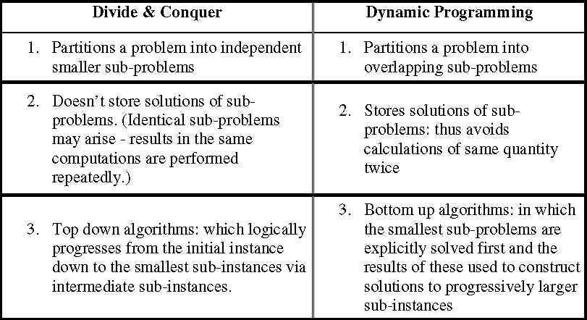
Dynamic Programming
Difference between Dynamic programming and Divide and Conquer approach.

Slide 5
Dynamic Programming
Is a Four-step methods
1. Characterize the structure of an optimal solution.
2. Recursively define the value of an optimal solution.
3. Compute the value of an optimal solution, typically in a bottom-up fashion.
4. Construct an optimal solution from computed information.

Slide 6
Dynamic Programming
Problems:
1. 0/1 Knapsack Problem
Floyd-Warshall Algorithm
Longest Common Sub-sequence
Matrix Chain Multiplication

Slide 7
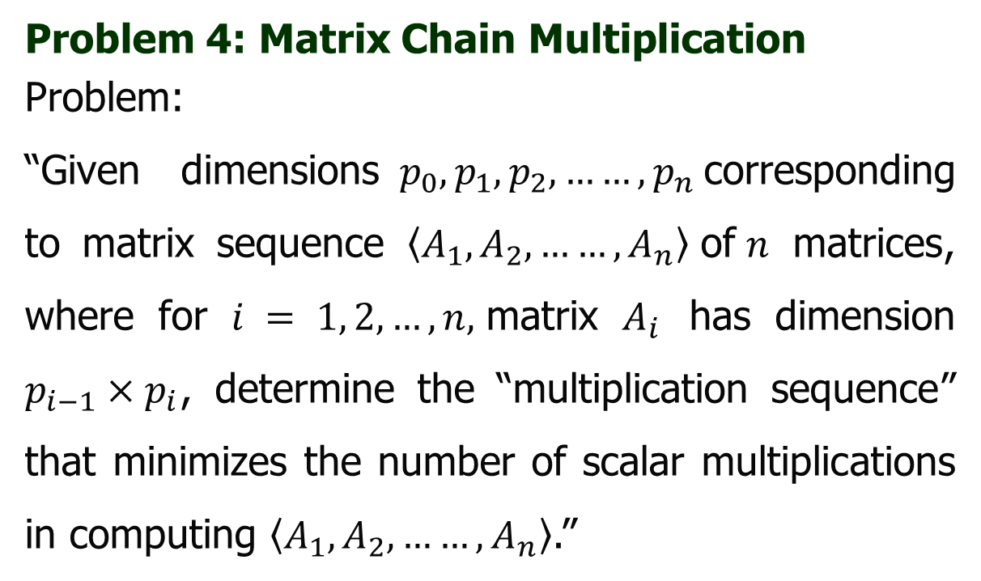
Dynamic Programming
Problem 4: Matrix Chain Multiplication
Problem:
“Given dimensions $p_{0}, p_{1},p_{2},……,p_{n}$corresponding to matrix sequence $\left\langle A_{1},A_{2},……,A_{n}\right\rangle$of$n$ matrices, where for $i = 1, 2, …, n,$matrix $A_{i}$ has dimension $p_{i−1}×p_{i}$, determine the “multiplication sequence” that minimizes the number of scalar multiplications in computing $\left\langle A_{1},A_{2},……,A_{n}\right\rangle$.”

Slide 8
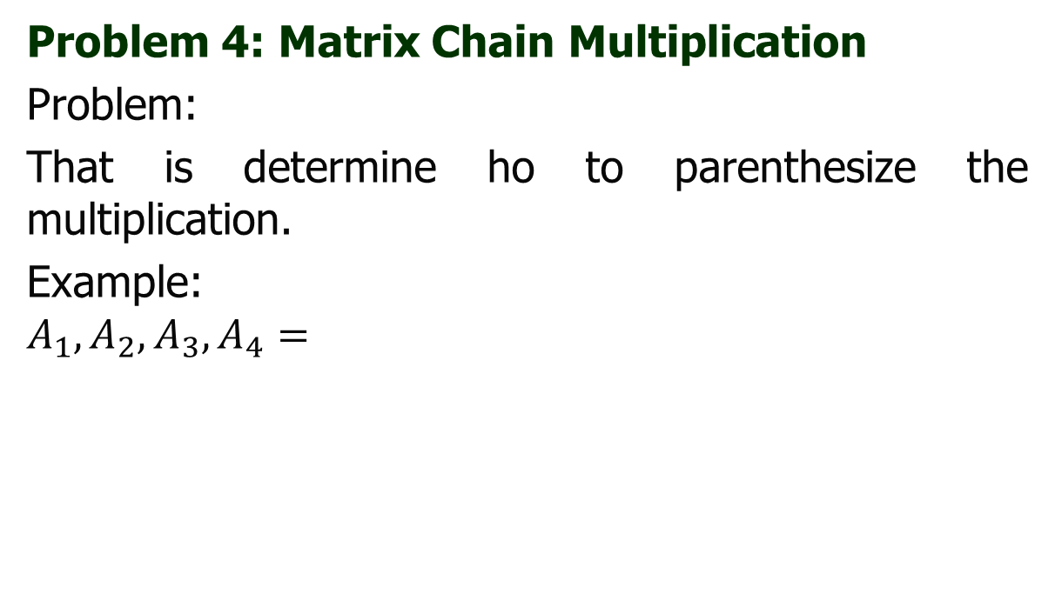

Dynamic Programming
Problem 4: Matrix Chain Multiplication
Problem:
That is determine ho to parenthesize the multiplication.
Example:
$$A_{1},A_{2},A_{3},A_{4}=$$
$${((A}_{1}A_{2})(A_{3}A_{4}))$$
$${(A}_{1}(A_{2}\left(A_{3}A_{4}\right)))$$
$${(A}_{1}((A_{2}A_{3}{)A}_{4}))$$
$${((A}_{1}A_{2})(A_{3}A_{4}))$$
$${(((A}_{1}A_{2})A_{3})A_{4})$$

Slide 9
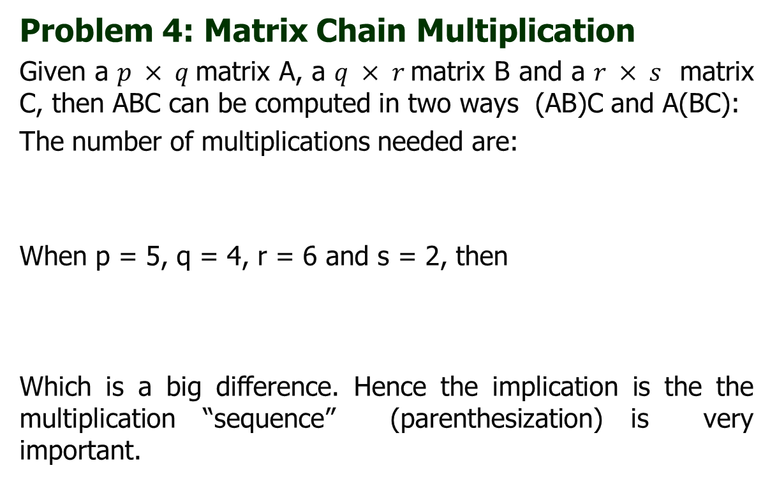
Dynamic Programming
Problem 4: Matrix Chain Multiplication
Given a $p × q$matrix A, a $q × r$matrix B and a $r × s$ matrix C, then ABC can be computed in two ways (AB)C and A(BC):
The number of multiplications needed are:
When p = 5, q = 4, r = 6 and s = 2, then
Which is a big difference. Hence the implication is the the multiplication “sequence” (parenthesization) is very important.
mult[(AB)C] | = | pqr + prs,
mult[A(BC)] | = | qrs + pqs.
mult[(AB)C] | = | 180,
mult[A(BC)] | = | 88.

Slide 10
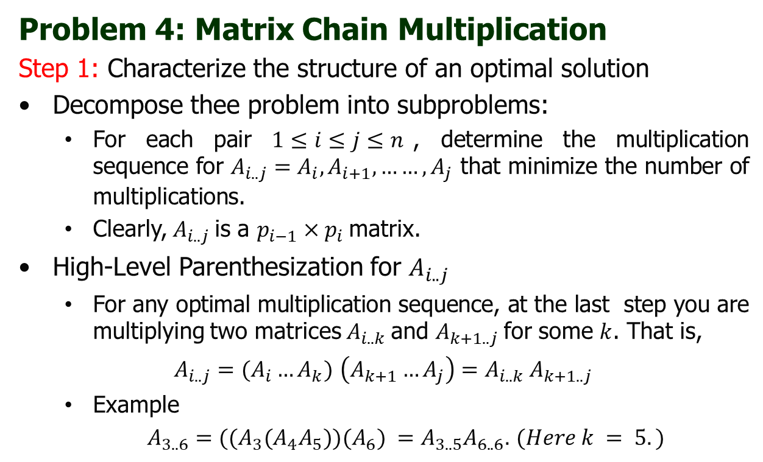
Dynamic Programming
Problem 4: Matrix Chain Multiplication
Step 1: Characterize the structure of an optimal solution
Decompose thee problem into subproblems:
  For each pair $1≤i≤j≤n$, determine the multiplication sequence for $A_{i..j}=A_{i},A_{i+1},……,A_{j}$ that minimize the number of multiplications.
  Clearly, $A_{i..j}$is a $p_{i−1}×p_{i}$matrix.
High-Level Parenthesization for $A_{i..j}$
  For any optimal multiplication sequence, at the last step you are multiplying two matrices $A_{i..k}$and $A_{k+1..j}$for some $k$. That is,
$A_{i..j}=(A_{i}…A_{k})$ $\left(A_{k+1}…A_{j}\right)=$ $A_{i..k} A_{k+1..j}$
  Example
  $A_{3..6}=((A_{3}(A_{4}A_{5}))(A_{6}) =A_{3..5}A_{6..6}.$ $(Here k = 5.)$

Slide 11
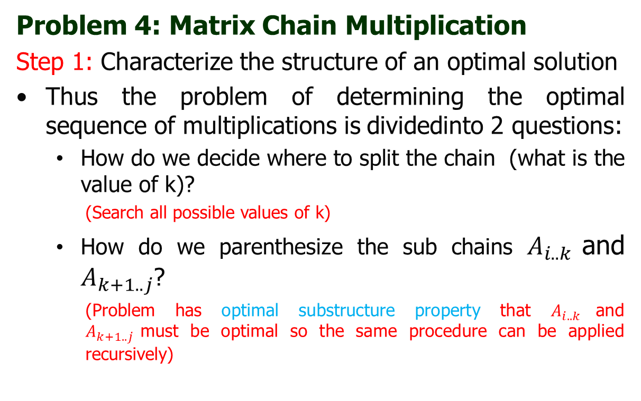
Dynamic Programming
Problem 4: Matrix Chain Multiplication
Step 1: Characterize the structure of an optimal solution
Thus the problem of determining the optimal sequence of multiplications is dividedinto 2 questions:
  How do we decide where to split the chain (what is the value of k)?
    (Search all possible values of k)
  How do we parenthesize the sub chains $A_{i..k}$and $A_{k+1..j}$?
    (Problem has optimal substructure property that $A_{i..k}$and $A_{k+1..j}$must be optimal so the same procedure can be applied recursively)

Slide 12
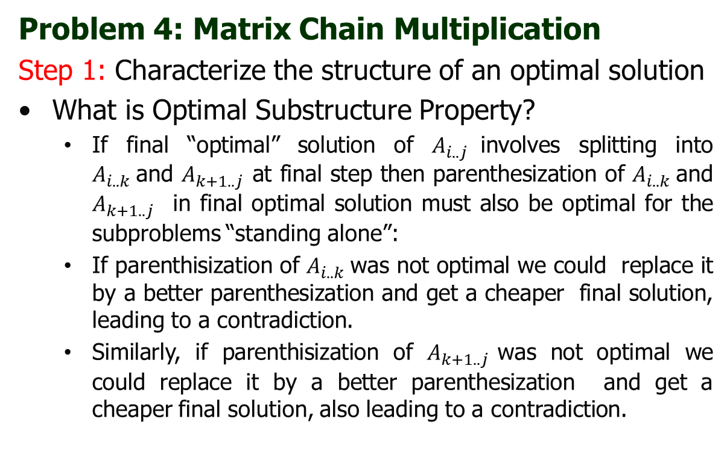
Dynamic Programming
Problem 4: Matrix Chain Multiplication
Step 1: Characterize the structure of an optimal solution
What is Optimal Substructure Property?
  If final “optimal” solution of $A_{i..j}$involves splitting into $A_{i..k}$and $A_{k+1..j}$ at final step then parenthesization of $A_{i..k}$and $A_{k+1..j}$ in final optimal solution must also be optimal for the subproblems “standing alone”:
  If parenthisization of $A_{i..k}$was not optimal we could replace it by a better parenthesization and get a cheaper final solution, leading to a contradiction.
  Similarly, if parenthisization of $A_{k+1..j}$was not optimal we could replace it by a better parenthesization and get a cheaper final solution, also leading to a contradiction.

Slide 13
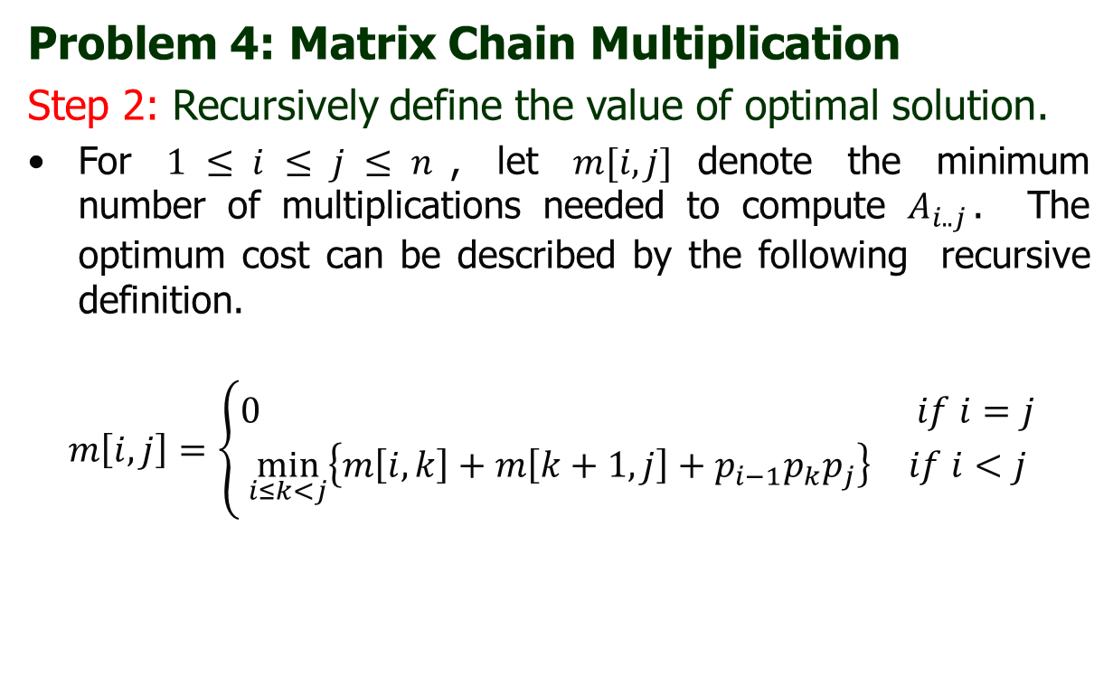
Dynamic Programming
Problem 4: Matrix Chain Multiplication
Step 2: Recursively define the value of optimal solution.
For $1 ≤ i ≤ j ≤ n$, let $m[i, j]$denote the minimum number of multiplications needed to compute $A_{i..j}$. The optimum cost can be described by the following recursive definition.
$$m\left[i,j\right]=\left\{\begin{aligned}\begin{matrix}0 & if i=j\end{matrix} \\ \begin{matrix}\min_{i≤k<j}\left\{m\left[i,k\right]+m\left[k+1,j\right]+p_{i−1}p_{k}p_{j}\right\} & if i<j\end{matrix}\end{aligned}\right.$$

Slide 14
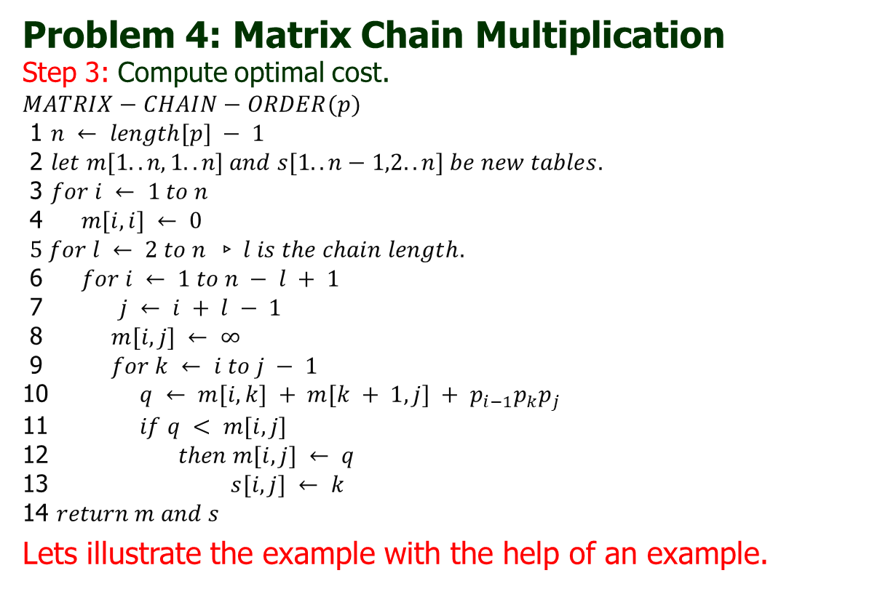
Dynamic Programming
Problem 4: Matrix Chain Multiplication
Step 3: Compute optimal cost.
$$MATRIX−CHAIN−ORDER(p)$$
1 $n ← length[p] − 1$
2 $let m[1..n,1..n] and s[1..n−1,2..n] be new tables.$
3 $for i ← 1 to n$
4 $m[i, i] ← 0$
$5 for l ← 2 to n ▹l is the chain length.$
6 $for i ← 1 to n − l + 1$
7 $j ← i + l − 1$
8 $m[i, j] ← ∞$
9 $for k ← i to j − 1$
10 $q ← m[i, k] + m[k + 1, j] + p_{i−1}p_{k}p_{j}$
11 $if q < m[i, j]$
12 $then m[i, j] ← q$
13 $s[i, j] ← k$
14 $return m and s$
Lets illustrate the example with the help of an example.

Slide 15
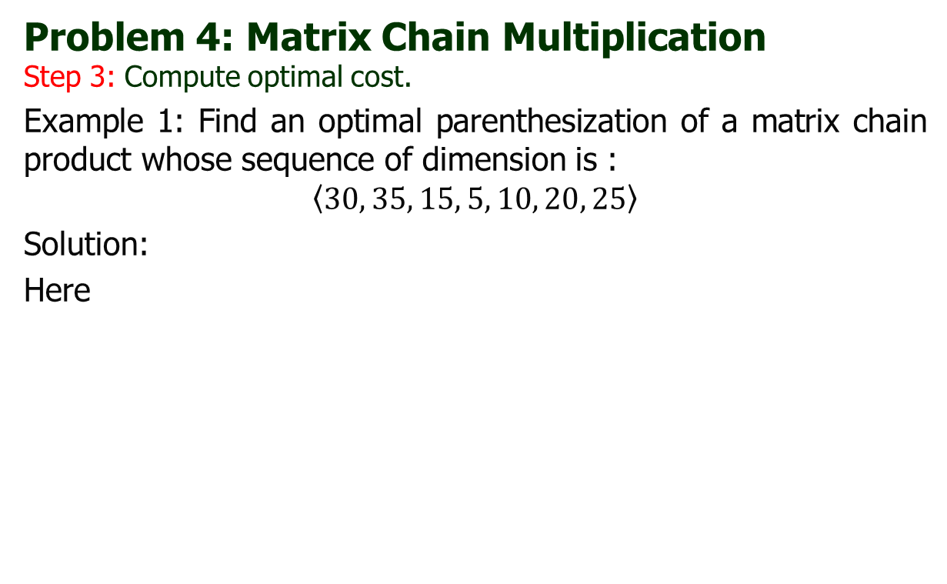
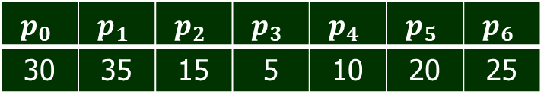
Dynamic Programming
Problem 4: Matrix Chain Multiplication
Step 3: Compute optimal cost.
Example 1: Find an optimal parenthesization of a matrix chain product whose sequence of dimension is :
$$\left\langle 30, 35, 15, 5, 10, 20, 25\right\rangle$$
Solution:
Here
$$p_{0}$$ | $$p_{1}$$ | $$p_{2}$$ | $$p_{3}$$ | $$p_{4}$$ | $$p_{5}$$ | $$p_{6}$$
30 | 35 | 15 | 5 | 10 | 20 | 25

Slide 16
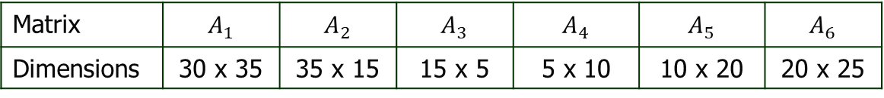
Dynamic Programming
Problem 4: Matrix Chain Multiplication
Step 3: Compute optimal cost.
Example 1: Find an optimal parenthesization of a matrix chain product whose sequence of dimension is :
$$\left\langle 30, 35, 15, 5, 10, 20, 25\right\rangle$$
Solution:
Here
$$p_{0}$$ | $$p_{1}$$ | $$p_{2}$$ | $$p_{3}$$ | $$p_{4}$$ | $$p_{5}$$ | $$p_{6}$$
30 | 35 | 15 | 5 | 10 | 20 | 25
Matrix | $$A_{1}$$ | $$A_{2}$$ | $$A_{3}$$ | $$A_{4}$$ | $$A_{5}$$ | $$A_{6}$$
Dimensions | 30 x 35 | 35 x 15 | 15 x 5 | 5 x 10 | 10 x 20 | 20 x 25

Slide 17

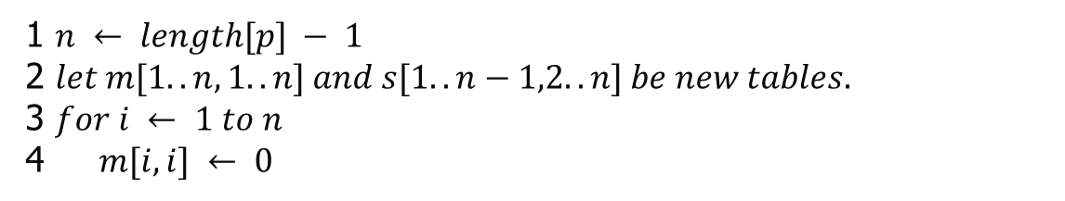



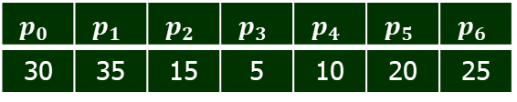


Dynamic Programming
Problem 4: Matrix Chain Multiplication
Step 3: Compute optimal cost.
Example 1: Find an optimal parenthesization of a matrix chain product whose sequence of dimension is :
Solution:
$$p_{0}$$ | $$p_{1}$$ | $$p_{2}$$ | $$p_{3}$$ | $$p_{4}$$ | $$p_{5}$$ | $$p_{6}$$
30 | 35 | 15 | 5 | 10 | 20 | 25
 | 1 | 2 | 3 | 4 | 5 | 6
1 | 0
2 |  | 0
3 |  |  | 0
4 |  |  |  | 0
5 |  |  |  |  | 0
6 |  |  |  |  |  | 0
 | 2 | 3 | 4 | 5 | 6
1
2
3
4
5
$$A_{1}$$
$$A_{2}$$
$$A_{3}$$
$$A_{4}$$
$$A_{5}$$
m matrix
$$A_{6}$$
s matrix
1 $n ← length[p] − 1$
2 $let m[1..n,1..n] and s[1..n−1,2..n] be new tables.$
3 $for i ← 1 to n$
4 $m[i, i] ← 0$

Slide 18
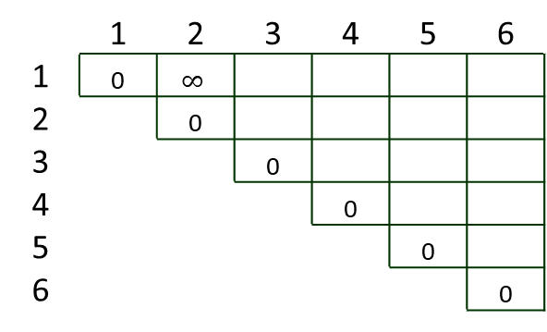
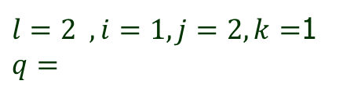

Dynamic Programming
Problem 4: Matrix Chain Multiplication
Step 3: Compute optimal cost.
Example 1: Find an optimal parenthesization of a matrix chain product whose sequence of dimension is :
Solution:
$$p_{0}$$ | $$p_{1}$$ | $$p_{2}$$ | $$p_{3}$$ | $$p_{4}$$ | $$p_{5}$$ | $$p_{6}$$
30 | 35 | 15 | 5 | 10 | 20 | 25
 | 1 | 2 | 3 | 4 | 5 | 6
1 | 0 | $$∞$$
2 |  | 0
3 |  |  | 0
4 |  |  |  | 0
5 |  |  |  |  | 0
6 |  |  |  |  |  | 0
 | 2 | 3 | 4 | 5 | 6
1
2
3
4
5
$$A_{1}$$
$$A_{2}$$
$$A_{3}$$
$$A_{4}$$
$$A_{5}$$
m matrix
$$A_{6}$$
s matrix
$5 for l ← 2 to n$
6 $for i ← 1 to n − l + 1$
7 $j ← i + l − 1$
8 $m[i, j] ← ∞$
9 $for k ← i to j − 1$
10 $q ← m[i, k] + m[k + 1, j] + p_{i−1}p_{k}p_{j}$
11 $if q < m[i, j]$
12 $then m[i, j] ← q$
13 $s[i, j] ← k$
$l=2 ,i=1, j=2, k=$1
$$q=$$

Slide 19

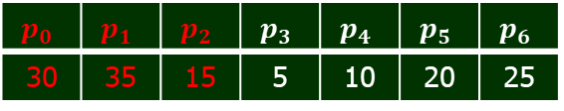
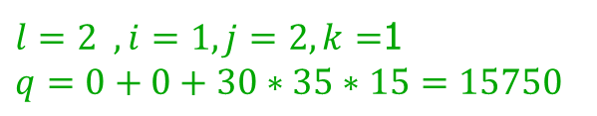
Dynamic Programming
Problem 4: Matrix Chain Multiplication
Step 3: Compute optimal cost.
Example 1: Find an optimal parenthesization of a matrix chain product whose sequence of dimension is :
Solution:
$$p_{0}$$ | $$p_{1}$$ | $$p_{2}$$ | $$p_{3}$$ | $$p_{4}$$ | $$p_{5}$$ | $$p_{6}$$
30 | 35 | 15 | 5 | 10 | 20 | 25
 | 1 | 2 | 3 | 4 | 5 | 6
1 | 0 | $$15750$$
2 |  | 0
3 |  |  | 0
4 |  |  |  | 0
5 |  |  |  |  | 0
6 |  |  |  |  |  | 0
 | 2 | 3 | 4 | 5 | 6
1 | 1
2
3
4
5
$$A_{1}$$
$$A_{2}$$
$$A_{3}$$
$$A_{4}$$
$$A_{5}$$
m matrix
$$A_{6}$$
s matrix
$5 for l ← 2 to n$
6 $for i ← 1 to n − l + 1$
7 $j ← i + l − 1$
8 $m[i, j] ← ∞$
9 $for k ← i to j − 1$
10 $q ← m[i, k] + m[k + 1, j] + p_{i−1}p_{k}p_{j}$
11 $if q < m[i, j]$
12 $then m[i, j] ← q$
13 $s[i, j] ← k$
$l=2 ,i=1, j=2, k=$1
$$q=0+0+30∗35∗15=15750$$

Slide 20

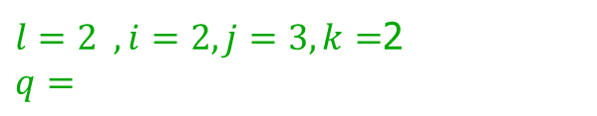
Dynamic Programming
Problem 4: Matrix Chain Multiplication
Step 3: Compute optimal cost.
Example 1: Find an optimal parenthesization of a matrix chain product whose sequence of dimension is :
Solution:
$$p_{0}$$ | $$p_{1}$$ | $$p_{2}$$ | $$p_{3}$$ | $$p_{4}$$ | $$p_{5}$$ | $$p_{6}$$
30 | 35 | 15 | 5 | 10 | 20 | 25
 | 1 | 2 | 3 | 4 | 5 | 6
1 | 0 | $$15750$$
2 |  | 0 | $$∞$$
3 |  |  | 0
4 |  |  |  | 0
5 |  |  |  |  | 0
6 |  |  |  |  |  | 0
 | 2 | 3 | 4 | 5 | 6
1 | 1
2
3
4
5
$$A_{1}$$
$$A_{2}$$
$$A_{3}$$
$$A_{4}$$
$$A_{5}$$
m matrix
$$A_{6}$$
s matrix
$5 for l ← 2 to n$
6 $for i ← 1 to n − l + 1$
7 $j ← i + l − 1$
8 $m[i, j] ← ∞$
9 $for k ← i to j − 1$
10 $q ← m[i, k] + m[k + 1, j] + p_{i−1}p_{k}p_{j}$
11 $if q < m[i, j]$
12 $then m[i, j] ← q$
13 $s[i, j] ← k$
$l=2 ,i=2, j=3, k=$2
$$q=$$

Slide 21
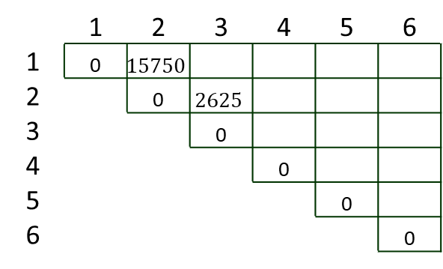
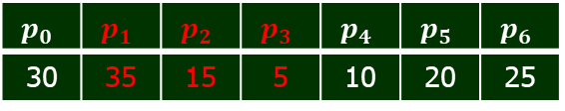
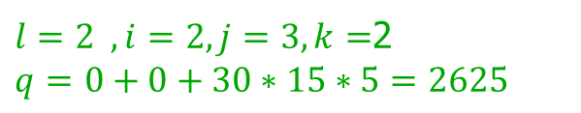
Dynamic Programming
Problem 4: Matrix Chain Multiplication
Step 3: Compute optimal cost.
Example 1: Find an optimal parenthesization of a matrix chain product whose sequence of dimension is :
Solution:
$$p_{0}$$ | $$p_{1}$$ | $$p_{2}$$ | $$p_{3}$$ | $$p_{4}$$ | $$p_{5}$$ | $$p_{6}$$
30 | 35 | 15 | 5 | 10 | 20 | 25
 | 1 | 2 | 3 | 4 | 5 | 6
1 | 0 | $$15750$$
2 |  | 0 | $$2625$$
3 |  |  | 0
4 |  |  |  | 0
5 |  |  |  |  | 0
6 |  |  |  |  |  | 0
 | 2 | 3 | 4 | 5 | 6
1 | 1
2 |  | 2
3
4
5
$$A_{1}$$
$$A_{2}$$
$$A_{3}$$
$$A_{4}$$
$$A_{5}$$
m matrix
$$A_{6}$$
s matrix
$5 for l ← 2 to n$
6 $for i ← 1 to n − l + 1$
7 $j ← i + l − 1$
8 $m[i, j] ← ∞$
9 $for k ← i to j − 1$
10 $q ← m[i, k] + m[k + 1, j] + p_{i−1}p_{k}p_{j}$
11 $if q < m[i, j]$
12 $then m[i, j] ← q$
13 $s[i, j] ← k$
$l=2 ,i=2, j=3, k=$2
$q=$ $0+0+30∗15∗5=2625$

Slide 22
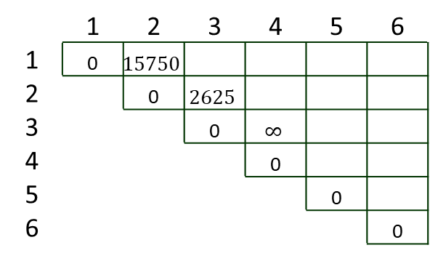
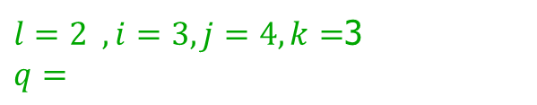
Dynamic Programming
Problem 4: Matrix Chain Multiplication
Step 3: Compute optimal cost.
Example 1: Find an optimal parenthesization of a matrix chain product whose sequence of dimension is :
Solution:
$$p_{0}$$ | $$p_{1}$$ | $$p_{2}$$ | $$p_{3}$$ | $$p_{4}$$ | $$p_{5}$$ | $$p_{6}$$
30 | 35 | 15 | 5 | 10 | 20 | 25
 | 1 | 2 | 3 | 4 | 5 | 6
1 | 0 | $$15750$$
2 |  | 0 | $$2625$$
3 |  |  | 0 | $$∞$$
4 |  |  |  | 0
5 |  |  |  |  | 0
6 |  |  |  |  |  | 0
 | 2 | 3 | 4 | 5 | 6
1 | 1
2 |  | 2
3
4
5
$$A_{1}$$
$$A_{2}$$
$$A_{3}$$
$$A_{4}$$
$$A_{5}$$
m matrix
$$A_{6}$$
s matrix
$5 for l ← 2 to n$
6 $for i ← 1 to n − l + 1$
7 $j ← i + l − 1$
8 $m[i, j] ← ∞$
9 $for k ← i to j − 1$
10 $q ← m[i, k] + m[k + 1, j] + p_{i−1}p_{k}p_{j}$
11 $if q < m[i, j]$
12 $then m[i, j] ← q$
13 $s[i, j] ← k$
$l=2 ,i=3, j=4, k=$3
$$q=$$

Slide 23

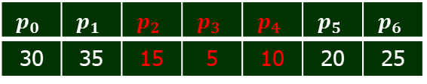
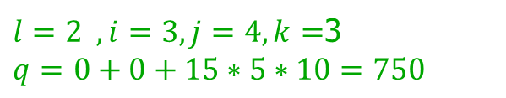
Dynamic Programming
Problem 4: Matrix Chain Multiplication
Step 3: Compute optimal cost.
Example 1: Find an optimal parenthesization of a matrix chain product whose sequence of dimension is :
Solution:
$$p_{0}$$ | $$p_{1}$$ | $$p_{2}$$ | $$p_{3}$$ | $$p_{4}$$ | $$p_{5}$$ | $$p_{6}$$
30 | 35 | 15 | 5 | 10 | 20 | 25
 | 1 | 2 | 3 | 4 | 5 | 6
1 | 0 | $$15750$$
2 |  | 0 | $$2625$$
3 |  |  | 0 | $$750$$
4 |  |  |  | 0
5 |  |  |  |  | 0
6 |  |  |  |  |  | 0
 | 2 | 3 | 4 | 5 | 6
1 | 1
2 |  | 2
3 |  |  | 3
4
5
$$A_{1}$$
$$A_{2}$$
$$A_{3}$$
$$A_{4}$$
$$A_{5}$$
m matrix
$$A_{6}$$
s matrix
$5 for l ← 2 to n$
6 $for i ← 1 to n − l + 1$
7 $j ← i + l − 1$
8 $m[i, j] ← ∞$
9 $for k ← i to j − 1$
10 $q ← m[i, k] + m[k + 1, j] + p_{i−1}p_{k}p_{j}$
11 $if q < m[i, j]$
12 $then m[i, j] ← q$
13 $s[i, j] ← k$
$l=2 ,i=3, j=4, k=$3
$q=$ $0+0+15∗5∗10=750$

Slide 24

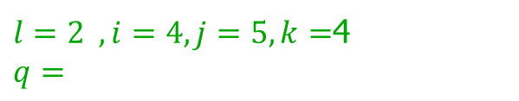
Dynamic Programming
Problem 4: Matrix Chain Multiplication
Step 3: Compute optimal cost.
Example 1: Find an optimal parenthesization of a matrix chain product whose sequence of dimension is :
Solution:
$$p_{0}$$ | $$p_{1}$$ | $$p_{2}$$ | $$p_{3}$$ | $$p_{4}$$ | $$p_{5}$$ | $$p_{6}$$
30 | 35 | 15 | 5 | 10 | 20 | 25
 | 1 | 2 | 3 | 4 | 5 | 6
1 | 0 | $$15750$$
2 |  | 0 | $$2625$$
3 |  |  | 0 | $$750$$
4 |  |  |  | 0 | $$∞$$
5 |  |  |  |  | 0
6 |  |  |  |  |  | 0
 | 2 | 3 | 4 | 5 | 6
1 | 1
2 |  | 2
3 |  |  | 3
4
5
$$A_{1}$$
$$A_{2}$$
$$A_{3}$$
$$A_{4}$$
$$A_{5}$$
m matrix
$$A_{6}$$
s matrix
$5 for l ← 2 to n$
6 $for i ← 1 to n − l + 1$
7 $j ← i + l − 1$
8 $m[i, j] ← ∞$
9 $for k ← i to j − 1$
10 $q ← m[i, k] + m[k + 1, j] + p_{i−1}p_{k}p_{j}$
11 $if q < m[i, j]$
12 $then m[i, j] ← q$
13 $s[i, j] ← k$
$l=2 ,i=4, j=5, k=$4
$$q=$$

Slide 25

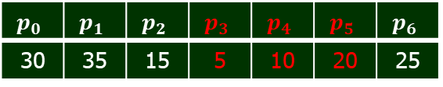
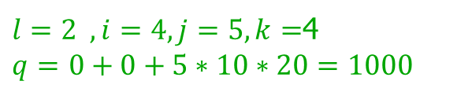
Dynamic Programming
Problem 4: Matrix Chain Multiplication
Step 3: Compute optimal cost.
Example 1: Find an optimal parenthesization of a matrix chain product whose sequence of dimension is :
Solution:
$$p_{0}$$ | $$p_{1}$$ | $$p_{2}$$ | $$p_{3}$$ | $$p_{4}$$ | $$p_{5}$$ | $$p_{6}$$
30 | 35 | 15 | 5 | 10 | 20 | 25
 | 1 | 2 | 3 | 4 | 5 | 6
1 | 0 | $$15750$$
2 |  | 0 | $$2625$$
3 |  |  | 0 | $$750$$
4 |  |  |  | 0 | $$1000$$
5 |  |  |  |  | 0
6 |  |  |  |  |  | 0
 | 2 | 3 | 4 | 5 | 6
1 | 1
2 |  | 2
3 |  |  | 3
4 |  |  |  | 4
5
$$A_{1}$$
$$A_{2}$$
$$A_{3}$$
$$A_{4}$$
$$A_{5}$$
m matrix
$$A_{6}$$
s matrix
$5 for l ← 2 to n$
6 $for i ← 1 to n − l + 1$
7 $j ← i + l − 1$
8 $m[i, j] ← ∞$
9 $for k ← i to j − 1$
10 $q ← m[i, k] + m[k + 1, j] + p_{i−1}p_{k}p_{j}$
11 $if q < m[i, j]$
12 $then m[i, j] ← q$
13 $s[i, j] ← k$
$l=2 ,i=4, j=5, k=$4
$q=$ $0+0+5∗10∗20=1000$

Slide 26
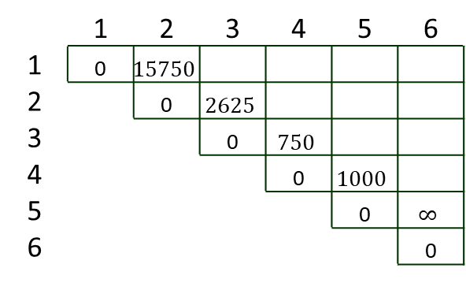
Dynamic Programming
Problem 4: Matrix Chain Multiplication
Step 3: Compute optimal cost.
Example 1: Find an optimal parenthesization of a matrix chain product whose sequence of dimension is :
Solution:
$$p_{0}$$ | $$p_{1}$$ | $$p_{2}$$ | $$p_{3}$$ | $$p_{4}$$ | $$p_{5}$$ | $$p_{6}$$
30 | 35 | 15 | 5 | 10 | 20 | 25
 | 1 | 2 | 3 | 4 | 5 | 6
1 | 0 | $$15750$$
2 |  | 0 | $$2625$$
3 |  |  | 0 | $$750$$
4 |  |  |  | 0 | $$1000$$
5 |  |  |  |  | 0 | $$∞$$
6 |  |  |  |  |  | 0
 | 2 | 3 | 4 | 5 | 6
1 | 1
2 |  | 2
3 |  |  | 3
4 |  |  |  | 4
5
$$A_{1}$$
$$A_{2}$$
$$A_{3}$$
$$A_{4}$$
$$A_{5}$$
m matrix
$$A_{6}$$
s matrix
$5 for l ← 2 to n$
6 $for i ← 1 to n − l + 1$
7 $j ← i + l − 1$
8 $m[i, j] ← ∞$
9 $for k ← i to j − 1$
10 $q ← m[i, k] + m[k + 1, j] + p_{i−1}p_{k}p_{j}$
11 $if q < m[i, j]$
12 $then m[i, j] ← q$
13 $s[i, j] ← k$
$l=2 ,i=4, j=5, k=$4
$$q=$$

Slide 27
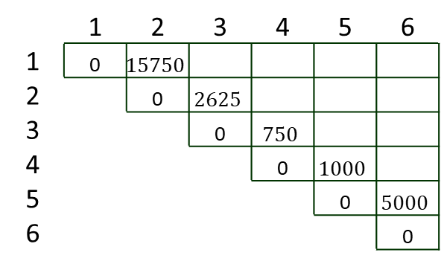
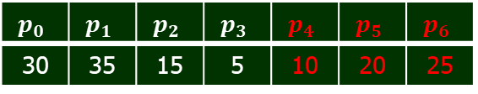
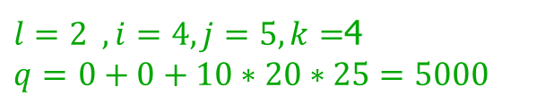
Dynamic Programming
Problem 4: Matrix Chain Multiplication
Step 3: Compute optimal cost.
Example 1: Find an optimal parenthesization of a matrix chain product whose sequence of dimension is :
Solution:
$$p_{0}$$ | $$p_{1}$$ | $$p_{2}$$ | $$p_{3}$$ | $$p_{4}$$ | $$p_{5}$$ | $$p_{6}$$
30 | 35 | 15 | 5 | 10 | 20 | 25
 | 1 | 2 | 3 | 4 | 5 | 6
1 | 0 | $$15750$$
2 |  | 0 | $$2625$$
3 |  |  | 0 | $$750$$
4 |  |  |  | 0 | $$1000$$
5 |  |  |  |  | 0 | $$5000$$
6 |  |  |  |  |  | 0
 | 2 | 3 | 4 | 5 | 6
1 | 1
2 |  | 2
3 |  |  | 3
4 |  |  |  | 4
5 |  |  |  |  | 5
$$A_{1}$$
$$A_{2}$$
$$A_{3}$$
$$A_{4}$$
$$A_{5}$$
m matrix
$$A_{6}$$
s matrix
$5 for l ← 2 to n$
6 $for i ← 1 to n − l + 1$
7 $j ← i + l − 1$
8 $m[i, j] ← ∞$
9 $for k ← i to j − 1$
10 $q ← m[i, k] + m[k + 1, j] + p_{i−1}p_{k}p_{j}$
11 $if q < m[i, j]$
12 $then m[i, j] ← q$
13 $s[i, j] ← k$
$l=2 ,i=4, j=5, k=$4
$q=$ $0+0+10∗20∗25=5000$

Slide 28

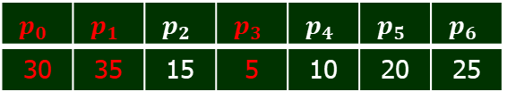
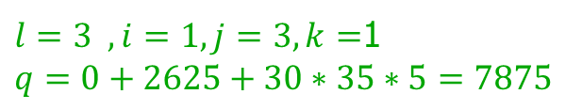
Dynamic Programming
Problem 4: Matrix Chain Multiplication
Step 3: Compute optimal cost.
Example 1: Find an optimal parenthesization of a matrix chain product whose sequence of dimension is :
Solution:
$$p_{0}$$ | $$p_{1}$$ | $$p_{2}$$ | $$p_{3}$$ | $$p_{4}$$ | $$p_{5}$$ | $$p_{6}$$
30 | 35 | 15 | 5 | 10 | 20 | 25
 | 1 | 2 | 3 | 4 | 5 | 6
1 | 0 | $$15750$$ | $$∞$$
2 |  | 0 | $$2625$$
3 |  |  | 0 | $$750$$
4 |  |  |  | 0 | $$1000$$
5 |  |  |  |  | 0 | $$5000$$
6 |  |  |  |  |  | 0
 | 2 | 3 | 4 | 5 | 6
1 | 1
2 |  | 2
3 |  |  | 3
4 |  |  |  | 4
5 |  |  |  |  | 5
$$A_{1}$$
$$A_{2}$$
$$A_{3}$$
$$A_{4}$$
$$A_{5}$$
m matrix
$$A_{6}$$
s matrix
$5 for l ← 2 to n$
6 $for i ← 1 to n − l + 1$
7 $j ← i + l − 1$
8 $m[i, j] ← ∞$
9 $for k ← i to j − 1$
10 $q ← m[i, k] + m[k + 1, j] + p_{i−1}p_{k}p_{j}$
11 $if q < m[i, j]$
12 $then m[i, j] ← q$
13 $s[i, j] ← k$
$l=3 ,i=1, j=3, k=$1
$$q=0+2625+30∗35∗5=7875$$

Slide 29
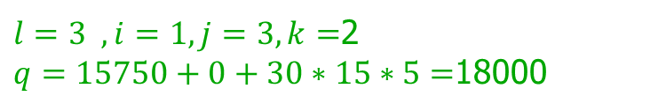
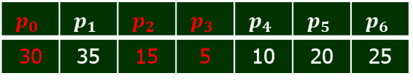
Dynamic Programming
Problem 4: Matrix Chain Multiplication
Step 3: Compute optimal cost.
Example 1: Find an optimal parenthesization of a matrix chain product whose sequence of dimension is :
Solution:
$$p_{0}$$ | $$p_{1}$$ | $$p_{2}$$ | $$p_{3}$$ | $$p_{4}$$ | $$p_{5}$$ | $$p_{6}$$
30 | 35 | 15 | 5 | 10 | 20 | 25
 | 1 | 2 | 3 | 4 | 5 | 6
1 | 0 | $$15750$$ | $$∞$$
2 |  | 0 | $$2625$$
3 |  |  | 0 | $$750$$
4 |  |  |  | 0 | $$1000$$
5 |  |  |  |  | 0 | $$5000$$
6 |  |  |  |  |  | 0
 | 2 | 3 | 4 | 5 | 6
1 | 1
2 |  | 2
3 |  |  | 3
4 |  |  |  | 4
5 |  |  |  |  | 5
$$A_{1}$$
$$A_{2}$$
$$A_{3}$$
$$A_{4}$$
$$A_{5}$$
m matrix
$$A_{6}$$
s matrix
$5 for l ← 2 to n$
6 $for i ← 1 to n − l + 1$
7 $j ← i + l − 1$
8 $m[i, j] ← ∞$
9 $for k ← i to j − 1$
10 $q ← m[i, k] + m[k + 1, j] + p_{i−1}p_{k}p_{j}$
11 $if q < m[i, j]$
12 $then m[i, j] ← q$
13 $s[i, j] ← k$
$l=3 ,i=1, j=3, k=$1
$$q=0+2625+30∗35∗5=7875$$
$l=3 ,i=1, j=3, k=$2
$q=15750+0+30∗15∗5=$18000

Slide 30
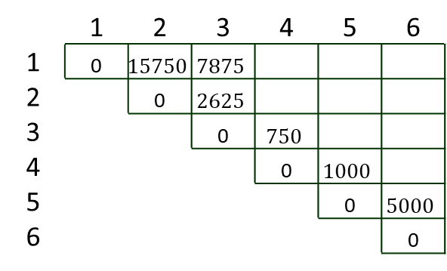
Dynamic Programming
Problem 4: Matrix Chain Multiplication
Step 3: Compute optimal cost.
Example 1: Find an optimal parenthesization of a matrix chain product whose sequence of dimension is :
Solution:
$$p_{0}$$ | $$p_{1}$$ | $$p_{2}$$ | $$p_{3}$$ | $$p_{4}$$ | $$p_{5}$$ | $$p_{6}$$
30 | 35 | 15 | 5 | 10 | 20 | 25
 | 1 | 2 | 3 | 4 | 5 | 6
1 | 0 | $$15750$$ | $$7875$$
2 |  | 0 | $$2625$$
3 |  |  | 0 | $$750$$
4 |  |  |  | 0 | $$1000$$
5 |  |  |  |  | 0 | $$5000$$
6 |  |  |  |  |  | 0
 | 2 | 3 | 4 | 5 | 6
1 | 1 | 1
2 |  | 2
3 |  |  | 3
4 |  |  |  | 4
5 |  |  |  |  | 5
$$A_{1}$$
$$A_{2}$$
$$A_{3}$$
$$A_{4}$$
$$A_{5}$$
m matrix
$$A_{6}$$
s matrix
$5 for l ← 2 to n$
6 $for i ← 1 to n − l + 1$
7 $j ← i + l − 1$
8 $m[i, j] ← ∞$
9 $for k ← i to j − 1$
10 $q ← m[i, k] + m[k + 1, j] + p_{i−1}p_{k}p_{j}$
11 $if q < m[i, j]$
12 $then m[i, j] ← q$
13 $s[i, j] ← k$
min
$l=3 ,i=1, j=3, k=$1
$$q=0+2625+30∗35∗5=7875$$
$l=3 ,i=1, j=3, k=$2
$q=15750+0+30∗15∗5=$18000

Slide 31

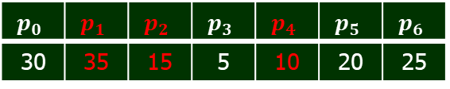
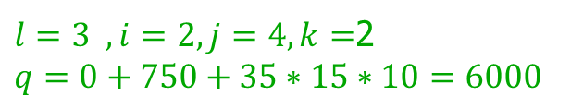
Dynamic Programming
Problem 4: Matrix Chain Multiplication
Step 3: Compute optimal cost.
Example 1: Find an optimal parenthesization of a matrix chain product whose sequence of dimension is :
Solution:
$$p_{0}$$ | $$p_{1}$$ | $$p_{2}$$ | $$p_{3}$$ | $$p_{4}$$ | $$p_{5}$$ | $$p_{6}$$
30 | 35 | 15 | 5 | 10 | 20 | 25
 | 1 | 2 | 3 | 4 | 5 | 6
1 | 0 | $$15750$$ | $$7875$$
2 |  | 0 | $$2625$$ | $$∞$$
3 |  |  | 0 | $$750$$
4 |  |  |  | 0 | $$1000$$
5 |  |  |  |  | 0 | $$5000$$
6 |  |  |  |  |  | 0
 | 2 | 3 | 4 | 5 | 6
1 | 1 | 1
2 |  | 2
3 |  |  | 3
4 |  |  |  | 4
5 |  |  |  |  | 5
$$A_{1}$$
$$A_{2}$$
$$A_{3}$$
$$A_{4}$$
$$A_{5}$$
m matrix
$$A_{6}$$
s matrix
$5 for l ← 2 to n$
6 $for i ← 1 to n − l + 1$
7 $j ← i + l − 1$
8 $m[i, j] ← ∞$
9 $for k ← i to j − 1$
10 $q ← m[i, k] + m[k + 1, j] + p_{i−1}p_{k}p_{j}$
11 $if q < m[i, j]$
12 $then m[i, j] ← q$
13 $s[i, j] ← k$
$l=3 ,i=2, j=4, k=$2
$$q=0+750+35∗15∗10=6000$$

Slide 32
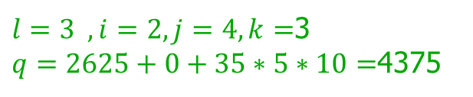
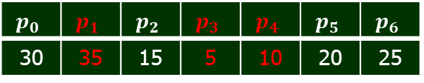
Dynamic Programming
Problem 4: Matrix Chain Multiplication
Step 3: Compute optimal cost.
Example 1: Find an optimal parenthesization of a matrix chain product whose sequence of dimension is :
Solution:
$$p_{0}$$ | $$p_{1}$$ | $$p_{2}$$ | $$p_{3}$$ | $$p_{4}$$ | $$p_{5}$$ | $$p_{6}$$
30 | 35 | 15 | 5 | 10 | 20 | 25
 | 1 | 2 | 3 | 4 | 5 | 6
1 | 0 | $$15750$$ | $$7875$$
2 |  | 0 | $$2625$$ | $$∞$$
3 |  |  | 0 | $$750$$
4 |  |  |  | 0 | $$1000$$
5 |  |  |  |  | 0 | $$5000$$
6 |  |  |  |  |  | 0
 | 2 | 3 | 4 | 5 | 6
1 | 1 | 1
2 |  | 2 | 3
3 |  |  | 3
4 |  |  |  | 4
5 |  |  |  |  | 5
$$A_{1}$$
$$A_{2}$$
$$A_{3}$$
$$A_{4}$$
$$A_{5}$$
m matrix
$$A_{6}$$
s matrix
$5 for l ← 2 to n$
6 $for i ← 1 to n − l + 1$
7 $j ← i + l − 1$
8 $m[i, j] ← ∞$
9 $for k ← i to j − 1$
10 $q ← m[i, k] + m[k + 1, j] + p_{i−1}p_{k}p_{j}$
11 $if q < m[i, j]$
12 $then m[i, j] ← q$
13 $s[i, j] ← k$
$l=3 ,i=2, j=4, k=$2
$$q=0+750+35∗15∗10=6000$$
$l=3 ,i=2, j=4, k=$3
$q=2625+0+35∗5∗10=$4375

Slide 33

Dynamic Programming
Problem 4: Matrix Chain Multiplication
Step 3: Compute optimal cost.
Example 1: Find an optimal parenthesization of a matrix chain product whose sequence of dimension is :
Solution:
$$p_{0}$$ | $$p_{1}$$ | $$p_{2}$$ | $$p_{3}$$ | $$p_{4}$$ | $$p_{5}$$ | $$p_{6}$$
30 | 35 | 15 | 5 | 10 | 20 | 25
 | 1 | 2 | 3 | 4 | 5 | 6
1 | 0 | $$15750$$ | $$7875$$
2 |  | 0 | $$2625$$ | $$4375$$
3 |  |  | 0 | $$750$$
4 |  |  |  | 0 | $$1000$$
5 |  |  |  |  | 0 | $$5000$$
6 |  |  |  |  |  | 0
 | 2 | 3 | 4 | 5 | 6
1 | 1 | 1
2 |  | 2 | 3
3 |  |  | 3
4 |  |  |  | 4
5 |  |  |  |  | 5
$$A_{1}$$
$$A_{2}$$
$$A_{3}$$
$$A_{4}$$
$$A_{5}$$
m matrix
$$A_{6}$$
s matrix
$5 for l ← 2 to n$
6 $for i ← 1 to n − l + 1$
7 $j ← i + l − 1$
8 $m[i, j] ← ∞$
9 $for k ← i to j − 1$
10 $q ← m[i, k] + m[k + 1, j] + p_{i−1}p_{k}p_{j}$
11 $if q < m[i, j]$
12 $then m[i, j] ← q$
13 $s[i, j] ← k$
$l=3 ,i=2, j=4, k=$2
$$q=0+750+35∗15∗10=6000$$
min
$l=3 ,i=2, j=4, k=$3
$q=2625+0+35∗5∗10=$4375

Slide 34

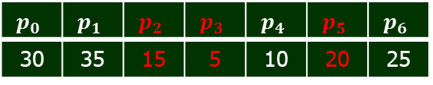
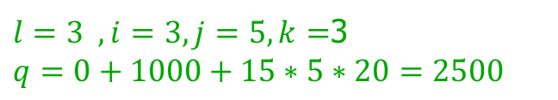
Dynamic Programming
Problem 4: Matrix Chain Multiplication
Step 3: Compute optimal cost.
Example 1: Find an optimal parenthesization of a matrix chain product whose sequence of dimension is :
Solution:
$$p_{0}$$ | $$p_{1}$$ | $$p_{2}$$ | $$p_{3}$$ | $$p_{4}$$ | $$p_{5}$$ | $$p_{6}$$
30 | 35 | 15 | 5 | 10 | 20 | 25
 | 1 | 2 | 3 | 4 | 5 | 6
1 | 0 | $$15750$$ | $$7875$$
2 |  | 0 | $$2625$$ | $$4375$$
3 |  |  | 0 | $$750$$ | $$∞$$
4 |  |  |  | 0 | $$1000$$
5 |  |  |  |  | 0 | $$5000$$
6 |  |  |  |  |  | 0
 | 2 | 3 | 4 | 5 | 6
1 | 1 | 1
2 |  | 2 | 3
3 |  |  | 3
4 |  |  |  | 4
5 |  |  |  |  | 5
$$A_{1}$$
$$A_{2}$$
$$A_{3}$$
$$A_{4}$$
$$A_{5}$$
m matrix
$$A_{6}$$
s matrix
$5 for l ← 2 to n$
6 $for i ← 1 to n − l + 1$
7 $j ← i + l − 1$
8 $m[i, j] ← ∞$
9 $for k ← i to j − 1$
10 $q ← m[i, k] + m[k + 1, j] + p_{i−1}p_{k}p_{j}$
11 $if q < m[i, j]$
12 $then m[i, j] ← q$
13 $s[i, j] ← k$
$l=3 ,i=3, j=5, k=$3
$$q=0+1000+15∗5∗20=2500$$

Slide 35
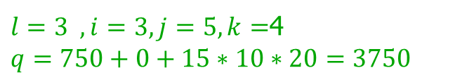
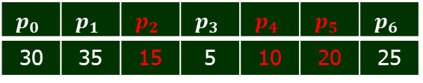
Dynamic Programming
Problem 4: Matrix Chain Multiplication
Step 3: Compute optimal cost.
Example 1: Find an optimal parenthesization of a matrix chain product whose sequence of dimension is :
Solution:
$$p_{0}$$ | $$p_{1}$$ | $$p_{2}$$ | $$p_{3}$$ | $$p_{4}$$ | $$p_{5}$$ | $$p_{6}$$
30 | 35 | 15 | 5 | 10 | 20 | 25
 | 1 | 2 | 3 | 4 | 5 | 6
1 | 0 | $$15750$$ | $$7875$$
2 |  | 0 | $$2625$$ | $$4375$$
3 |  |  | 0 | $$750$$ | $$∞$$
4 |  |  |  | 0 | $$1000$$
5 |  |  |  |  | 0 | $$5000$$
6 |  |  |  |  |  | 0
 | 2 | 3 | 4 | 5 | 6
1 | 1 | 1
2 |  | 2 | 3
3 |  |  | 3
4 |  |  |  | 4
5 |  |  |  |  | 5
$$A_{1}$$
$$A_{2}$$
$$A_{3}$$
$$A_{4}$$
$$A_{5}$$
m matrix
$$A_{6}$$
s matrix
$5 for l ← 2 to n$
6 $for i ← 1 to n − l + 1$
7 $j ← i + l − 1$
8 $m[i, j] ← ∞$
9 $for k ← i to j − 1$
10 $q ← m[i, k] + m[k + 1, j] + p_{i−1}p_{k}p_{j}$
11 $if q < m[i, j]$
12 $then m[i, j] ← q$
13 $s[i, j] ← k$
$l=3 ,i=3, j=5, k=$3
$$q=0+1000+15∗5∗20=2500$$
$l=3 ,i=3, j=5, k=$4
$$q=750+0+15∗10∗20=3750$$

Slide 36

Dynamic Programming
Problem 4: Matrix Chain Multiplication
Step 3: Compute optimal cost.
Example 1: Find an optimal parenthesization of a matrix chain product whose sequence of dimension is :
Solution:
$$p_{0}$$ | $$p_{1}$$ | $$p_{2}$$ | $$p_{3}$$ | $$p_{4}$$ | $$p_{5}$$ | $$p_{6}$$
30 | 35 | 15 | 5 | 10 | 20 | 25
 | 1 | 2 | 3 | 4 | 5 | 6
1 | 0 | $$15750$$ | $$7875$$
2 |  | 0 | $$2625$$ | $$4375$$
3 |  |  | 0 | $$750$$ | $$2500$$
4 |  |  |  | 0 | $$1000$$
5 |  |  |  |  | 0 | $$5000$$
6 |  |  |  |  |  | 0
 | 2 | 3 | 4 | 5 | 6
1 | 1 | 1
2 |  | 2 | 3
3 |  |  | 3 | 3
4 |  |  |  | 4
5 |  |  |  |  | 5
$$A_{1}$$
$$A_{2}$$
$$A_{3}$$
$$A_{4}$$
$$A_{5}$$
m matrix
$$A_{6}$$
s matrix
min
$5 for l ← 2 to n$
6 $for i ← 1 to n − l + 1$
7 $j ← i + l − 1$
8 $m[i, j] ← ∞$
9 $for k ← i to j − 1$
10 $q ← m[i, k] + m[k + 1, j] + p_{i−1}p_{k}p_{j}$
11 $if q < m[i, j]$
12 $then m[i, j] ← q$
13 $s[i, j] ← k$
$l=3 ,i=3, j=5, k=$3
$$q=0+1000+15∗5∗20=2500$$
$l=3 ,i=3, j=5, k=$4
$$q=750+0+15∗10∗20=3750$$

Slide 37
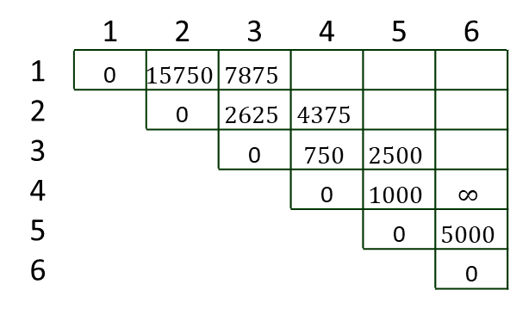
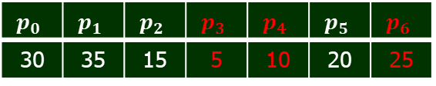

Dynamic Programming
Problem 4: Matrix Chain Multiplication
Step 3: Compute optimal cost.
Example 1: Find an optimal parenthesization of a matrix chain product whose sequence of dimension is :
Solution:
$$p_{0}$$ | $$p_{1}$$ | $$p_{2}$$ | $$p_{3}$$ | $$p_{4}$$ | $$p_{5}$$ | $$p_{6}$$
30 | 35 | 15 | 5 | 10 | 20 | 25
 | 1 | 2 | 3 | 4 | 5 | 6
1 | 0 | $$15750$$ | $$7875$$
2 |  | 0 | $$2625$$ | $$4375$$
3 |  |  | 0 | $$750$$ | $$2500$$
4 |  |  |  | 0 | $$1000$$ | $$∞$$
5 |  |  |  |  | 0 | $$5000$$
6 |  |  |  |  |  | 0
 | 2 | 3 | 4 | 5 | 6
1 | 1 | 1
2 |  | 2 | 3
3 |  |  | 3
4 |  |  |  | 4
5 |  |  |  |  | 5
$$A_{1}$$
$$A_{2}$$
$$A_{3}$$
$$A_{4}$$
$$A_{5}$$
m matrix
$$A_{6}$$
s matrix
$5 for l ← 2 to n$
6 $for i ← 1 to n − l + 1$
7 $j ← i + l − 1$
8 $m[i, j] ← ∞$
9 $for k ← i to j − 1$
10 $q ← m[i, k] + m[k + 1, j] + p_{i−1}p_{k}p_{j}$
11 $if q < m[i, j]$
12 $then m[i, j] ← q$
13 $s[i, j] ← k$
$l=3 ,i=4, j=6, k=$4
$$q=0+5000+5∗10∗25=6250$$

Slide 38


Dynamic Programming
Problem 4: Matrix Chain Multiplication
Step 3: Compute optimal cost.
Example 1: Find an optimal parenthesization of a matrix chain product whose sequence of dimension is :
Solution:
$$p_{0}$$ | $$p_{1}$$ | $$p_{2}$$ | $$p_{3}$$ | $$p_{4}$$ | $$p_{5}$$ | $$p_{6}$$
30 | 35 | 15 | 5 | 10 | 20 | 25
 | 1 | 2 | 3 | 4 | 5 | 6
1 | 0 | $$15750$$ | $$7875$$
2 |  | 0 | $$2625$$ | $$4375$$
3 |  |  | 0 | $$750$$ | $$2500$$
4 |  |  |  | 0 | $$1000$$ | $$∞$$
5 |  |  |  |  | 0 | $$5000$$
6 |  |  |  |  |  | 0
 | 2 | 3 | 4 | 5 | 6
1 | 1 | 1
2 |  | 2 | 3
3 |  |  | 3
4 |  |  |  | 4
5 |  |  |  |  | 5
$$A_{1}$$
$$A_{2}$$
$$A_{3}$$
$$A_{4}$$
$$A_{5}$$
m matrix
$$A_{6}$$
s matrix
$5 for l ← 2 to n$
6 $for i ← 1 to n − l + 1$
7 $j ← i + l − 1$
8 $m[i, j] ← ∞$
9 $for k ← i to j − 1$
10 $q ← m[i, k] + m[k + 1, j] + p_{i−1}p_{k}p_{j}$
11 $if q < m[i, j]$
12 $then m[i, j] ← q$
13 $s[i, j] ← k$
$l=3 ,i=4, j=6, k=$4
$$q=0+5000+5∗10∗25=6250$$
$l=3 ,i=4, j=6, k=$5
$$q=1000+0+5∗20∗25=3500$$

Slide 39

Dynamic Programming
Problem 4: Matrix Chain Multiplication
Step 3: Compute optimal cost.
Example 1: Find an optimal parenthesization of a matrix chain product whose sequence of dimension is :
Solution:
$$p_{0}$$ | $$p_{1}$$ | $$p_{2}$$ | $$p_{3}$$ | $$p_{4}$$ | $$p_{5}$$ | $$p_{6}$$
30 | 35 | 15 | 5 | 10 | 20 | 25
 | 1 | 2 | 3 | 4 | 5 | 6
1 | 0 | $$15750$$ | $$7875$$
2 |  | 0 | $$2625$$ | $$4375$$
3 |  |  | 0 | $$750$$ | $$2500$$
4 |  |  |  | 0 | $$1000$$ | 3500
5 |  |  |  |  | 0 | $$5000$$
6 |  |  |  |  |  | 0
 | 2 | 3 | 4 | 5 | 6
1 | 1 | 1
2 |  | 2 | 3
3 |  |  | 3 | 3
4 |  |  |  | 4 | 5
5 |  |  |  |  | 5
$$A_{1}$$
$$A_{2}$$
$$A_{3}$$
$$A_{4}$$
$$A_{5}$$
m matrix
$$A_{6}$$
s matrix
$5 for l ← 2 to n$
6 $for i ← 1 to n − l + 1$
7 $j ← i + l − 1$
8 $m[i, j] ← ∞$
9 $for k ← i to j − 1$
10 $q ← m[i, k] + m[k + 1, j] + p_{i−1}p_{k}p_{j}$
11 $if q < m[i, j]$
12 $then m[i, j] ← q$
13 $s[i, j] ← k$
$l=3 ,i=4, j=6, k=$4
$$q=0+5000+5∗10∗25=6250$$
min
$l=3 ,i=4, j=6, k=$5
$$q=1000+0+5∗20∗25=3500$$

Slide 40



Dynamic Programming
Problem 4: Matrix Chain Multiplication
Step 3: Compute optimal cost.
Example 1: Find an optimal parenthesization of a matrix chain product whose sequence of dimension is :
Solution:
$$p_{0}$$ | $$p_{1}$$ | $$p_{2}$$ | $$p_{3}$$ | $$p_{4}$$ | $$p_{5}$$ | $$p_{6}$$
30 | 35 | 15 | 5 | 10 | 20 | 25
 | 1 | 2 | 3 | 4 | 5 | 6
1 | 0 | $$15750$$ | $$7875$$ | $$∞$$
2 |  | 0 | $$2625$$ | $$4375$$
3 |  |  | 0 | $$750$$ | $$2500$$
4 |  |  |  | 0 | $$1000$$ | 3500
5 |  |  |  |  | 0 | $$5000$$
6 |  |  |  |  |  | 0
 | 2 | 3 | 4 | 5 | 6
1 | 1 | 1
2 |  | 2 | 3
3 |  |  | 3 | 3
4 |  |  |  | 4 | 5
5 |  |  |  |  | 5
$$A_{1}$$
$$A_{2}$$
$$A_{3}$$
$$A_{4}$$
$$A_{5}$$
m matrix
$$A_{6}$$
s matrix
$5 for l ← 2 to n$
6 $for i ← 1 to n − l + 1$
7 $j ← i + l − 1$
8 $m[i, j] ← ∞$
9 $for k ← i to j − 1$
10 $q ← m[i, k] + m[k + 1, j] + p_{i−1}p_{k}p_{j}$
11 $if q < m[i, j]$
12 $then m[i, j] ← q$
13 $s[i, j] ← k$
$$l=3 ,i=1, j=4$$
$$k=\text{1}, q=0+4375+30∗35∗10=14875$$

Slide 41


Dynamic Programming
Problem 4: Matrix Chain Multiplication
Step 3: Compute optimal cost.
Example 1: Find an optimal parenthesization of a matrix chain product whose sequence of dimension is :
Solution:
$$p_{0}$$ | $$p_{1}$$ | $$p_{2}$$ | $$p_{3}$$ | $$p_{4}$$ | $$p_{5}$$ | $$p_{6}$$
30 | 35 | 15 | 5 | 10 | 20 | 25
 | 1 | 2 | 3 | 4 | 5 | 6
1 | 0 | $$15750$$ | $$7875$$ | $$∞$$
2 |  | 0 | $$2625$$ | $$4375$$
3 |  |  | 0 | $$750$$ | $$2500$$
4 |  |  |  | 0 | $$1000$$ | 3500
5 |  |  |  |  | 0 | $$5000$$
6 |  |  |  |  |  | 0
 | 2 | 3 | 4 | 5 | 6
1 | 1 | 1
2 |  | 2 | 3
3 |  |  | 3 | 3
4 |  |  |  | 4 | 5
5 |  |  |  |  | 5
$$A_{1}$$
$$A_{2}$$
$$A_{3}$$
$$A_{4}$$
$$A_{5}$$
m matrix
$$A_{6}$$
s matrix
$5 for l ← 2 to n$
6 $for i ← 1 to n − l + 1$
7 $j ← i + l − 1$
8 $m[i, j] ← ∞$
9 $for k ← i to j − 1$
10 $q ← m[i, k] + m[k + 1, j] + p_{i−1}p_{k}p_{j}$
11 $if q < m[i, j]$
12 $then m[i, j] ← q$
13 $s[i, j] ← k$
$$l=3 ,i=1, j=4$$
$$k=\text{1}, q=0+4375+30∗35∗10=14875$$
$k=\text{2}, q=15750+750+30∗15∗10=$18000

Slide 42



Dynamic Programming
Problem 4: Matrix Chain Multiplication
Step 3: Compute optimal cost.
Example 1: Find an optimal parenthesization of a matrix chain product whose sequence of dimension is :
Solution:
$$p_{0}$$ | $$p_{1}$$ | $$p_{2}$$ | $$p_{3}$$ | $$p_{4}$$ | $$p_{5}$$ | $$p_{6}$$
30 | 35 | 15 | 5 | 10 | 20 | 25
 | 1 | 2 | 3 | 4 | 5 | 6
1 | 0 | $$15750$$ | $$7875$$ | $$9375$$
2 |  | 0 | $$2625$$ | $$4375$$
3 |  |  | 0 | $$750$$ | $$2500$$
4 |  |  |  | 0 | $$1000$$ | 3500
5 |  |  |  |  | 0 | $$5000$$
6 |  |  |  |  |  | 0
 | 2 | 3 | 4 | 5 | 6
1 | 1 | 1 | 3
2 |  | 2 | 3
3 |  |  | 3 | 3
4 |  |  |  | 4 | 5
5 |  |  |  |  | 5
$$A_{1}$$
$$A_{2}$$
$$A_{3}$$
$$A_{4}$$
$$A_{5}$$
m matrix
$$A_{6}$$
s matrix
$5 for l ← 2 to n$
6 $for i ← 1 to n − l + 1$
7 $j ← i + l − 1$
8 $m[i, j] ← ∞$
9 $for k ← i to j − 1$
10 $q ← m[i, k] + m[k + 1, j] + p_{i−1}p_{k}p_{j}$
11 $if q < m[i, j]$
12 $then m[i, j] ← q$
13 $s[i, j] ← k$
$$l=3 ,i=1, j=4$$
$$k=\text{1}, q=0+4375+30∗35∗10=14875$$
$k=\text{2}, q=15750+750+30∗15∗10=$18000
$$k=\text{3}, q=7875+0+30∗5∗10=9375$$

Slide 43
Dynamic Programming
Problem 4: Matrix Chain Multiplication
Step 3: Compute optimal cost.
Example 1: Find an optimal parenthesization of a matrix chain product whose sequence of dimension is :
Solution:
$$p_{0}$$ | $$p_{1}$$ | $$p_{2}$$ | $$p_{3}$$ | $$p_{4}$$ | $$p_{5}$$ | $$p_{6}$$
30 | 35 | 15 | 5 | 10 | 20 | 25
 | 1 | 2 | 3 | 4 | 5 | 6
1 | 0 | $$15750$$ | $$7875$$ | $$9375$$
2 |  | 0 | $$2625$$ | $$4375$$
3 |  |  | 0 | $$750$$ | $$2500$$
4 |  |  |  | 0 | $$1000$$ | 3500
5 |  |  |  |  | 0 | $$5000$$
6 |  |  |  |  |  | 0
 | 2 | 3 | 4 | 5 | 6
1 | 1 | 1 | 3
2 |  | 2 | 3
3 |  |  | 3 | 3
4 |  |  |  | 4 | 5
5 |  |  |  |  | 5
$$A_{1}$$
$$A_{2}$$
$$A_{3}$$
$$A_{4}$$
$$A_{5}$$
m matrix
$$A_{6}$$
s matrix
$5 for l ← 2 to n$
6 $for i ← 1 to n − l + 1$
7 $j ← i + l − 1$
8 $m[i, j] ← ∞$
9 $for k ← i to j − 1$
10 $q ← m[i, k] + m[k + 1, j] + p_{i−1}p_{k}p_{j}$
11 $if q < m[i, j]$
12 $then m[i, j] ← q$
13 $s[i, j] ← k$
$$l=3 ,i=1, j=4$$
$$k=\text{1}, q=0+4375+30∗35∗10=14875$$
$k=\text{2}, q=15750+750+30∗15∗10=$18000
$$k=\text{3}, q=7875+0+30∗5∗10=9375$$
min

Slide 44



Dynamic Programming
Problem 4: Matrix Chain Multiplication
Step 3: Compute optimal cost.
Example 1: Find an optimal parenthesization of a matrix chain product whose sequence of dimension is :
Solution:
$$p_{0}$$ | $$p_{1}$$ | $$p_{2}$$ | $$p_{3}$$ | $$p_{4}$$ | $$p_{5}$$ | $$p_{6}$$
30 | 35 | 15 | 5 | 10 | 20 | 25
 | 1 | 2 | 3 | 4 | 5 | 6
1 | 0 | $$15750$$ | $$7875$$ | $$9375$$
2 |  | 0 | $$2625$$ | $$4375$$ | $$∞$$
3 |  |  | 0 | $$750$$ | $$2500$$
4 |  |  |  | 0 | $$1000$$ | 3500
5 |  |  |  |  | 0 | $$5000$$
6 |  |  |  |  |  | 0
 | 2 | 3 | 4 | 5 | 6
1 | 1 | 1 | 3
2 |  | 2 | 3
3 |  |  | 3 | 3
4 |  |  |  | 4 | 5
5 |  |  |  |  | 5
$$A_{1}$$
$$A_{2}$$
$$A_{3}$$
$$A_{4}$$
$$A_{5}$$
m matrix
$$A_{6}$$
s matrix
$5 for l ← 2 to n$
6 $for i ← 1 to n − l + 1$
7 $j ← i + l − 1$
8 $m[i, j] ← ∞$
9 $for k ← i to j − 1$
10 $q ← m[i, k] + m[k + 1, j] + p_{i−1}p_{k}p_{j}$
11 $if q < m[i, j]$
12 $then m[i, j] ← q$
13 $s[i, j] ← k$
$$l=3 ,i=2, j=5$$
$$k=\text{2}, q=0+4375+35∗15∗20=10500$$

Slide 45


Dynamic Programming
Problem 4: Matrix Chain Multiplication
Step 3: Compute optimal cost.
Example 1: Find an optimal parenthesization of a matrix chain product whose sequence of dimension is :
Solution:
$$p_{0}$$ | $$p_{1}$$ | $$p_{2}$$ | $$p_{3}$$ | $$p_{4}$$ | $$p_{5}$$ | $$p_{6}$$
30 | 35 | 15 | 5 | 10 | 20 | 25
 | 1 | 2 | 3 | 4 | 5 | 6
1 | 0 | $$15750$$ | $$7875$$ | $$9375$$
2 |  | 0 | $$2625$$ | $$4375$$ | $$∞$$
3 |  |  | 0 | $$750$$ | $$2500$$
4 |  |  |  | 0 | $$1000$$ | 3500
5 |  |  |  |  | 0 | $$5000$$
6 |  |  |  |  |  | 0
 | 2 | 3 | 4 | 5 | 6
1 | 1 | 1 | 3
2 |  | 2 | 3
3 |  |  | 3 | 3
4 |  |  |  | 4 | 5
5 |  |  |  |  | 5
$$A_{1}$$
$$A_{2}$$
$$A_{3}$$
$$A_{4}$$
$$A_{5}$$
m matrix
$$A_{6}$$
s matrix
$5 for l ← 2 to n$
6 $for i ← 1 to n − l + 1$
7 $j ← i + l − 1$
8 $m[i, j] ← ∞$
9 $for k ← i to j − 1$
10 $q ← m[i, k] + m[k + 1, j] + p_{i−1}p_{k}p_{j}$
11 $if q < m[i, j]$
12 $then m[i, j] ← q$
13 $s[i, j] ← k$
$$l=3 ,i=2, j=5$$
$$k=\text{2}, q=0+4375+35∗15∗20=10500$$
$$k=3, q=2625+1000+35∗5∗20=7125$$

Slide 46


Dynamic Programming
Problem 4: Matrix Chain Multiplication
Step 3: Compute optimal cost.
Example 1: Find an optimal parenthesization of a matrix chain product whose sequence of dimension is :
Solution:
$$p_{0}$$ | $$p_{1}$$ | $$p_{2}$$ | $$p_{3}$$ | $$p_{4}$$ | $$p_{5}$$ | $$p_{6}$$
30 | 35 | 15 | 5 | 10 | 20 | 25
 | 1 | 2 | 3 | 4 | 5 | 6
1 | 0 | $$15750$$ | $$7875$$ | $$9375$$
2 |  | 0 | $$2625$$ | $$4375$$ | $$∞$$
3 |  |  | 0 | $$750$$ | $$2500$$
4 |  |  |  | 0 | $$1000$$ | 3500
5 |  |  |  |  | 0 | $$5000$$
6 |  |  |  |  |  | 0
 | 2 | 3 | 4 | 5 | 6
1 | 1 | 1 | 3
2 |  | 2 | 3
3 |  |  | 3 | 3
4 |  |  |  | 4 | 5
5 |  |  |  |  | 5
$$A_{1}$$
$$A_{2}$$
$$A_{3}$$
$$A_{4}$$
$$A_{5}$$
m matrix
$$A_{6}$$
s matrix
$5 for l ← 2 to n$
6 $for i ← 1 to n − l + 1$
7 $j ← i + l − 1$
8 $m[i, j] ← ∞$
9 $for k ← i to j − 1$
10 $q ← m[i, k] + m[k + 1, j] + p_{i−1}p_{k}p_{j}$
11 $if q < m[i, j]$
12 $then m[i, j] ← q$
13 $s[i, j] ← k$
$$l=3 ,i=2, j=5$$
$$k=\text{2}, q=0+4375+35∗15∗20=10500$$
$$k=3, q=2625+1000+35∗5∗20=7125$$
$$k=4, q=4375+0+35∗10∗20=11375$$

Slide 47

Dynamic Programming
Problem 4: Matrix Chain Multiplication
Step 3: Compute optimal cost.
Example 1: Find an optimal parenthesization of a matrix chain product whose sequence of dimension is :
Solution:
$$p_{0}$$ | $$p_{1}$$ | $$p_{2}$$ | $$p_{3}$$ | $$p_{4}$$ | $$p_{5}$$ | $$p_{6}$$
30 | 35 | 15 | 5 | 10 | 20 | 25
 | 1 | 2 | 3 | 4 | 5 | 6
1 | 0 | $$15750$$ | $$7875$$ | $$9375$$
2 |  | 0 | $$2625$$ | $$4375$$ | $$7125$$
3 |  |  | 0 | $$750$$ | $$2500$$
4 |  |  |  | 0 | $$1000$$ | 3500
5 |  |  |  |  | 0 | $$5000$$
6 |  |  |  |  |  | 0
 | 2 | 3 | 4 | 5 | 6
1 | 1 | 1 | 3
2 |  | 2 | 3 | 3
3 |  |  | 3 | 3
4 |  |  |  | 4 | 5
5 |  |  |  |  | 5
$$A_{1}$$
$$A_{2}$$
$$A_{3}$$
$$A_{4}$$
$$A_{5}$$
m matrix
$$A_{6}$$
s matrix
$5 for l ← 2 to n$
6 $for i ← 1 to n − l + 1$
7 $j ← i + l − 1$
8 $m[i, j] ← ∞$
9 $for k ← i to j − 1$
10 $q ← m[i, k] + m[k + 1, j] + p_{i−1}p_{k}p_{j}$
11 $if q < m[i, j]$
12 $then m[i, j] ← q$
13 $s[i, j] ← k$
$$l=3 ,i=2, j=5$$
$$k=\text{2}, q=0+4375+35∗15∗20=10500$$
$$k=3, q=2625+1000+35∗5∗20=7125$$
$$k=4, q=4375+0+35∗10∗20=11375$$
min

Slide 48



Dynamic Programming
Problem 4: Matrix Chain Multiplication
Step 3: Compute optimal cost.
Example 1: Find an optimal parenthesization of a matrix chain product whose sequence of dimension is :
Solution:
$$p_{0}$$ | $$p_{1}$$ | $$p_{2}$$ | $$p_{3}$$ | $$p_{4}$$ | $$p_{5}$$ | $$p_{6}$$
30 | 35 | 15 | 5 | 10 | 20 | 25
 | 1 | 2 | 3 | 4 | 5 | 6
1 | 0 | $$15750$$ | $$7875$$ | $$9375$$
2 |  | 0 | $$2625$$ | $$4375$$ | $$7125$$
3 |  |  | 0 | $$750$$ | $$2500$$ | $$∞$$
4 |  |  |  | 0 | $$1000$$ | 3500
5 |  |  |  |  | 0 | $$5000$$
6 |  |  |  |  |  | 0
 | 2 | 3 | 4 | 5 | 6
1 | 1 | 1 | 3
2 |  | 2 | 3 | 3
3 |  |  | 3 | 3
4 |  |  |  | 4 | 5
5 |  |  |  |  | 5
$$A_{1}$$
$$A_{2}$$
$$A_{3}$$
$$A_{4}$$
$$A_{5}$$
m matrix
$$A_{6}$$
s matrix
$5 for l ← 2 to n$
6 $for i ← 1 to n − l + 1$
7 $j ← i + l − 1$
8 $m[i, j] ← ∞$
9 $for k ← i to j − 1$
10 $q ← m[i, k] + m[k + 1, j] + p_{i−1}p_{k}p_{j}$
11 $if q < m[i, j]$
12 $then m[i, j] ← q$
13 $s[i, j] ← k$
$$l=3 ,i=3, j=6$$
$$k=\text{3}, q=0+3500+15∗5∗25=5375$$

Slide 49


Dynamic Programming
Problem 4: Matrix Chain Multiplication
Step 3: Compute optimal cost.
Example 1: Find an optimal parenthesization of a matrix chain product whose sequence of dimension is :
Solution:
$$p_{0}$$ | $$p_{1}$$ | $$p_{2}$$ | $$p_{3}$$ | $$p_{4}$$ | $$p_{5}$$ | $$p_{6}$$
30 | 35 | 15 | 5 | 10 | 20 | 25
 | 1 | 2 | 3 | 4 | 5 | 6
1 | 0 | $$15750$$ | $$7875$$ | $$9375$$
2 |  | 0 | $$2625$$ | $$4375$$ | $$7125$$
3 |  |  | 0 | $$750$$ | $$2500$$ | $$∞$$
4 |  |  |  | 0 | $$1000$$ | 3500
5 |  |  |  |  | 0 | $$5000$$
6 |  |  |  |  |  | 0
 | 2 | 3 | 4 | 5 | 6
1 | 1 | 1 | 3
2 |  | 2 | 3 | 3
3 |  |  | 3 | 3
4 |  |  |  | 4 | 5
5 |  |  |  |  | 5
$$A_{1}$$
$$A_{2}$$
$$A_{3}$$
$$A_{4}$$
$$A_{5}$$
m matrix
$$A_{6}$$
s matrix
$5 for l ← 2 to n$
6 $for i ← 1 to n − l + 1$
7 $j ← i + l − 1$
8 $m[i, j] ← ∞$
9 $for k ← i to j − 1$
10 $q ← m[i, k] + m[k + 1, j] + p_{i−1}p_{k}p_{j}$
11 $if q < m[i, j]$
12 $then m[i, j] ← q$
13 $s[i, j] ← k$
$$l=3 ,i=3, j=6$$
$$k=\text{3}, q=0+3500+15∗5∗25=5375$$
$k=\text{4}, q=750+5000+15∗10∗25=$9500

Slide 50


Dynamic Programming
Problem 4: Matrix Chain Multiplication
Step 3: Compute optimal cost.
Example 1: Find an optimal parenthesization of a matrix chain product whose sequence of dimension is :
Solution:
$$p_{0}$$ | $$p_{1}$$ | $$p_{2}$$ | $$p_{3}$$ | $$p_{4}$$ | $$p_{5}$$ | $$p_{6}$$
30 | 35 | 15 | 5 | 10 | 20 | 25
 | 1 | 2 | 3 | 4 | 5 | 6
1 | 0 | $$15750$$ | $$7875$$ | $$9375$$
2 |  | 0 | $$2625$$ | $$4375$$ | $$7125$$
3 |  |  | 0 | $$750$$ | $$2500$$ | $$∞$$
4 |  |  |  | 0 | $$1000$$ | 3500
5 |  |  |  |  | 0 | $$5000$$
6 |  |  |  |  |  | 0
 | 2 | 3 | 4 | 5 | 6
1 | 1 | 1 | 3
2 |  | 2 | 3 | 3
3 |  |  | 3 | 3
4 |  |  |  | 4 | 5
5 |  |  |  |  | 5
$$A_{1}$$
$$A_{2}$$
$$A_{3}$$
$$A_{4}$$
$$A_{5}$$
m matrix
$$A_{6}$$
s matrix
$5 for l ← 2 to n$
6 $for i ← 1 to n − l + 1$
7 $j ← i + l − 1$
8 $m[i, j] ← ∞$
9 $for k ← i to j − 1$
10 $q ← m[i, k] + m[k + 1, j] + p_{i−1}p_{k}p_{j}$
11 $if q < m[i, j]$
12 $then m[i, j] ← q$
13 $s[i, j] ← k$
$$l=3 ,i=3, j=6$$
$$k=\text{3}, q=0+3500+15∗5∗25=5375$$
$k=\text{4}, q=750+5000+15∗10∗25=$9500
$$k=\text{5}, q=2500+0+15∗20∗25=10000$$

Slide 51

Dynamic Programming
Problem 4: Matrix Chain Multiplication
Step 3: Compute optimal cost.
Example 1: Find an optimal parenthesization of a matrix chain product whose sequence of dimension is :
Solution:
$$p_{0}$$ | $$p_{1}$$ | $$p_{2}$$ | $$p_{3}$$ | $$p_{4}$$ | $$p_{5}$$ | $$p_{6}$$
30 | 35 | 15 | 5 | 10 | 20 | 25
 | 1 | 2 | 3 | 4 | 5 | 6
1 | 0 | $$15750$$ | $$7875$$ | $$9375$$
2 |  | 0 | $$2625$$ | $$4375$$ | $$7125$$
3 |  |  | 0 | $$750$$ | $$2500$$ | $$5375$$
4 |  |  |  | 0 | $$1000$$ | 3500
5 |  |  |  |  | 0 | $$5000$$
6 |  |  |  |  |  | 0
 | 2 | 3 | 4 | 5 | 6
1 | 1 | 1 | 3
2 |  | 2 | 3 | 3
3 |  |  | 3 | 3 | 3
4 |  |  |  | 4 | 5
5 |  |  |  |  | 5
$$A_{1}$$
$$A_{2}$$
$$A_{3}$$
$$A_{4}$$
$$A_{5}$$
m matrix
$$A_{6}$$
s matrix
$5 for l ← 2 to n$
6 $for i ← 1 to n − l + 1$
7 $j ← i + l − 1$
8 $m[i, j] ← ∞$
9 $for k ← i to j − 1$
10 $q ← m[i, k] + m[k + 1, j] + p_{i−1}p_{k}p_{j}$
11 $if q < m[i, j]$
12 $then m[i, j] ← q$
13 $s[i, j] ← k$
$$l=3 ,i=3, j=6$$
$$k=\text{3}, q=0+3500+15∗5∗25=5375$$
$k=\text{4}, q=750+5000+15∗10∗25=$9500
$$k=\text{5}, q=2500+0+15∗20∗25=10000$$
min

Slide 52



Dynamic Programming
Problem 4: Matrix Chain Multiplication
Step 3: Compute optimal cost.
Example 1: Find an optimal parenthesization of a matrix chain product whose sequence of dimension is :
Solution:
$$p_{0}$$ | $$p_{1}$$ | $$p_{2}$$ | $$p_{3}$$ | $$p_{4}$$ | $$p_{5}$$ | $$p_{6}$$
30 | 35 | 15 | 5 | 10 | 20 | 25
 | 1 | 2 | 3 | 4 | 5 | 6
1 | 0 | $$15750$$ | $$7875$$ | $$9375$$ | $$∞$$
2 |  | 0 | $$2625$$ | $$4375$$ | $$7125$$
3 |  |  | 0 | $$750$$ | $$2500$$ | $$5375$$
4 |  |  |  | 0 | $$1000$$ | 3500
5 |  |  |  |  | 0 | $$5000$$
6 |  |  |  |  |  | 0
 | 2 | 3 | 4 | 5 | 6
1 | 1 | 1 | 3
2 |  | 2 | 3 | 3
3 |  |  | 3 | 3 | 3
4 |  |  |  | 4 | 5
5 |  |  |  |  | 5
$$A_{1}$$
$$A_{2}$$
$$A_{3}$$
$$A_{4}$$
$$A_{5}$$
m matrix
$$A_{6}$$
s matrix
$5 for l ← 2 to n$
6 $for i ← 1 to n − l + 1$
7 $j ← i + l − 1$
8 $m[i, j] ← ∞$
9 $for k ← i to j − 1$
10 $q ← m[i, k] + m[k + 1, j] + p_{i−1}p_{k}p_{j}$
11 $if q < m[i, j]$
12 $then m[i, j] ← q$
13 $s[i, j] ← k$
$$l=4 ,i=1, j=5$$
$$k=\text{1}, q=0+7125+30∗35∗20=28125$$

Slide 53


Dynamic Programming
Problem 4: Matrix Chain Multiplication
Step 3: Compute optimal cost.
Example 1: Find an optimal parenthesization of a matrix chain product whose sequence of dimension is :
Solution:
$$p_{0}$$ | $$p_{1}$$ | $$p_{2}$$ | $$p_{3}$$ | $$p_{4}$$ | $$p_{5}$$ | $$p_{6}$$
30 | 35 | 15 | 5 | 10 | 20 | 25
 | 1 | 2 | 3 | 4 | 5 | 6
1 | 0 | $$15750$$ | $$7875$$ | $$9375$$ | $$∞$$
2 |  | 0 | $$2625$$ | $$4375$$ | $$7125$$
3 |  |  | 0 | $$750$$ | $$2500$$ | $$5375$$
4 |  |  |  | 0 | $$1000$$ | 3500
5 |  |  |  |  | 0 | $$5000$$
6 |  |  |  |  |  | 0
 | 2 | 3 | 4 | 5 | 6
1 | 1 | 1 | 3
2 |  | 2 | 3 | 3
3 |  |  | 3 | 3 | 3
4 |  |  |  | 4 | 5
5 |  |  |  |  | 5
$$A_{1}$$
$$A_{2}$$
$$A_{3}$$
$$A_{4}$$
$$A_{5}$$
m matrix
$$A_{6}$$
s matrix
$5 for l ← 2 to n$
6 $for i ← 1 to n − l + 1$
7 $j ← i + l − 1$
8 $m[i, j] ← ∞$
9 $for k ← i to j − 1$
10 $q ← m[i, k] + m[k + 1, j] + p_{i−1}p_{k}p_{j}$
11 $if q < m[i, j]$
12 $then m[i, j] ← q$
13 $s[i, j] ← k$
$$l=4 ,i=1, j=5$$
$$k=\text{1}, q=0+7125+30∗35∗20=28125$$
$$k=\text{2}, q=15750+2500+30∗15∗20=27250$$

Slide 54


Dynamic Programming
Problem 4: Matrix Chain Multiplication
Step 3: Compute optimal cost.
Example 1: Find an optimal parenthesization of a matrix chain product whose sequence of dimension is :
Solution:
$$p_{0}$$ | $$p_{1}$$ | $$p_{2}$$ | $$p_{3}$$ | $$p_{4}$$ | $$p_{5}$$ | $$p_{6}$$
30 | 35 | 15 | 5 | 10 | 20 | 25
 | 1 | 2 | 3 | 4 | 5 | 6
1 | 0 | $$15750$$ | $$7875$$ | $$9375$$ | $$∞$$
2 |  | 0 | $$2625$$ | $$4375$$ | $$7125$$
3 |  |  | 0 | $$750$$ | $$2500$$ | $$5375$$
4 |  |  |  | 0 | $$1000$$ | 3500
5 |  |  |  |  | 0 | $$5000$$
6 |  |  |  |  |  | 0
 | 2 | 3 | 4 | 5 | 6
1 | 1 | 1 | 3
2 |  | 2 | 3 | 3
3 |  |  | 3 | 3 | 3
4 |  |  |  | 4 | 5
5 |  |  |  |  | 5
$$A_{1}$$
$$A_{2}$$
$$A_{3}$$
$$A_{4}$$
$$A_{5}$$
m matrix
$$A_{6}$$
s matrix
$5 for l ← 2 to n$
6 $for i ← 1 to n − l + 1$
7 $j ← i + l − 1$
8 $m[i, j] ← ∞$
9 $for k ← i to j − 1$
10 $q ← m[i, k] + m[k + 1, j] + p_{i−1}p_{k}p_{j}$
11 $if q < m[i, j]$
12 $then m[i, j] ← q$
13 $s[i, j] ← k$
$$l=4 ,i=1, j=5$$
$$k=\text{1}, q=0+7125+30∗35∗20=28125$$
$$k=\text{2}, q=15750+2500+30∗15∗20=27250$$
$$k=\text{3}, q=7875+1000+30∗5∗20=11875$$

Slide 55


Dynamic Programming
Problem 4: Matrix Chain Multiplication
Step 3: Compute optimal cost.
Example 1: Find an optimal parenthesization of a matrix chain product whose sequence of dimension is :
Solution:
$$p_{0}$$ | $$p_{1}$$ | $$p_{2}$$ | $$p_{3}$$ | $$p_{4}$$ | $$p_{5}$$ | $$p_{6}$$
30 | 35 | 15 | 5 | 10 | 20 | 25
 | 1 | 2 | 3 | 4 | 5 | 6
1 | 0 | $$15750$$ | $$7875$$ | $$9375$$ | $$∞$$
2 |  | 0 | $$2625$$ | $$4375$$ | $$7125$$
3 |  |  | 0 | $$750$$ | $$2500$$ | $$5375$$
4 |  |  |  | 0 | $$1000$$ | 3500
5 |  |  |  |  | 0 | $$5000$$
6 |  |  |  |  |  | 0
 | 2 | 3 | 4 | 5 | 6
1 | 1 | 1 | 3
2 |  | 2 | 3 | 3
3 |  |  | 3 | 3 | 3
4 |  |  |  | 4 | 5
5 |  |  |  |  | 5
$$A_{1}$$
$$A_{2}$$
$$A_{3}$$
$$A_{4}$$
$$A_{5}$$
m matrix
$$A_{6}$$
s matrix
$5 for l ← 2 to n$
6 $for i ← 1 to n − l + 1$
7 $j ← i + l − 1$
8 $m[i, j] ← ∞$
9 $for k ← i to j − 1$
10 $q ← m[i, k] + m[k + 1, j] + p_{i−1}p_{k}p_{j}$
11 $if q < m[i, j]$
12 $then m[i, j] ← q$
13 $s[i, j] ← k$
$$l=4 ,i=1, j=5$$
$$k=\text{1}, q=0+7125+30∗35∗20=28125$$
$$k=\text{2}, q=15750+2500+30∗15∗20=27250$$
$$k=\text{3}, q=7875+1000+30∗5∗20=11875$$
$$k=\text{4}, q=9375+0+30∗10∗20=15375$$

Slide 56

Dynamic Programming
Problem 4: Matrix Chain Multiplication
Step 3: Compute optimal cost.
Example 1: Find an optimal parenthesization of a matrix chain product whose sequence of dimension is :
Solution:
$$p_{0}$$ | $$p_{1}$$ | $$p_{2}$$ | $$p_{3}$$ | $$p_{4}$$ | $$p_{5}$$ | $$p_{6}$$
30 | 35 | 15 | 5 | 10 | 20 | 25
 | 1 | 2 | 3 | 4 | 5 | 6
1 | 0 | $$15750$$ | $$7875$$ | $$9375$$ | $$11875$$
2 |  | 0 | $$2625$$ | $$4375$$ | $$7125$$
3 |  |  | 0 | $$750$$ | $$2500$$ | $$5375$$
4 |  |  |  | 0 | $$1000$$ | 3500
5 |  |  |  |  | 0 | $$5000$$
6 |  |  |  |  |  | 0
 | 2 | 3 | 4 | 5 | 6
1 | 1 | 1 | 3 | 3
2 |  | 2 | 3 | 3
3 |  |  | 3 | 3 | 3
4 |  |  |  | 4 | 5
5 |  |  |  |  | 5
$$A_{1}$$
$$A_{2}$$
$$A_{3}$$
$$A_{4}$$
$$A_{5}$$
m matrix
$$A_{6}$$
s matrix
$5 for l ← 2 to n$
6 $for i ← 1 to n − l + 1$
7 $j ← i + l − 1$
8 $m[i, j] ← ∞$
9 $for k ← i to j − 1$
10 $q ← m[i, k] + m[k + 1, j] + p_{i−1}p_{k}p_{j}$
11 $if q < m[i, j]$
12 $then m[i, j] ← q$
13 $s[i, j] ← k$
$$l=4 ,i=1, j=5$$
$$k=\text{1}, q=0+7125+30∗35∗20=28125$$
$$k=\text{2}, q=15750+2500+30∗15∗20=27250$$
$$k=\text{3}, q=7875+1000+30∗5∗20=11875$$
$$k=\text{4}, q=9375+0+30∗10∗20=15375$$
min

Slide 57



Dynamic Programming
Problem 4: Matrix Chain Multiplication
Step 3: Compute optimal cost.
Example 1: Find an optimal parenthesization of a matrix chain product whose sequence of dimension is :
Solution:
$$p_{0}$$ | $$p_{1}$$ | $$p_{2}$$ | $$p_{3}$$ | $$p_{4}$$ | $$p_{5}$$ | $$p_{6}$$
30 | 35 | 15 | 5 | 10 | 20 | 25
 | 1 | 2 | 3 | 4 | 5 | 6
1 | 0 | $$15750$$ | $$7875$$ | $$9375$$ | $$11875$$
2 |  | 0 | $$2625$$ | $$4375$$ | $$7125$$ | $$∞$$
3 |  |  | 0 | $$750$$ | $$2500$$ | $$5375$$
4 |  |  |  | 0 | $$1000$$ | 3500
5 |  |  |  |  | 0 | $$5000$$
6 |  |  |  |  |  | 0
 | 2 | 3 | 4 | 5 | 6
1 | 1 | 1 | 3 | 3
2 |  | 2 | 3 | 3
3 |  |  | 3 | 3 | 3
4 |  |  |  | 4 | 5
5 |  |  |  |  | 5
$$A_{1}$$
$$A_{2}$$
$$A_{3}$$
$$A_{4}$$
$$A_{5}$$
m matrix
$$A_{6}$$
s matrix
$5 for l ← 2 to n$
6 $for i ← 1 to n − l + 1$
7 $j ← i + l − 1$
8 $m[i, j] ← ∞$
9 $for k ← i to j − 1$
10 $q ← m[i, k] + m[k + 1, j] + p_{i−1}p_{k}p_{j}$
11 $if q < m[i, j]$
12 $then m[i, j] ← q$
13 $s[i, j] ← k$
$$l=4 ,i=2, j=6$$
$$k=\text{2}, q=0+5375+35∗15∗25=15375$$

Slide 58


Dynamic Programming
Problem 4: Matrix Chain Multiplication
Step 3: Compute optimal cost.
Example 1: Find an optimal parenthesization of a matrix chain product whose sequence of dimension is :
Solution:
$$p_{0}$$ | $$p_{1}$$ | $$p_{2}$$ | $$p_{3}$$ | $$p_{4}$$ | $$p_{5}$$ | $$p_{6}$$
30 | 35 | 15 | 5 | 10 | 20 | 25
 | 1 | 2 | 3 | 4 | 5 | 6
1 | 0 | $$15750$$ | $$7875$$ | $$9375$$ | $$11875$$
2 |  | 0 | $$2625$$ | $$4375$$ | $$7125$$ | $$∞$$
3 |  |  | 0 | $$750$$ | $$2500$$ | $$5375$$
4 |  |  |  | 0 | $$1000$$ | 3500
5 |  |  |  |  | 0 | $$5000$$
6 |  |  |  |  |  | 0
 | 2 | 3 | 4 | 5 | 6
1 | 1 | 1 | 3 | 3
2 |  | 2 | 3 | 3
3 |  |  | 3 | 3 | 3
4 |  |  |  | 4 | 5
5 |  |  |  |  | 5
$$A_{1}$$
$$A_{2}$$
$$A_{3}$$
$$A_{4}$$
$$A_{5}$$
m matrix
$$A_{6}$$
s matrix
$5 for l ← 2 to n$
6 $for i ← 1 to n − l + 1$
7 $j ← i + l − 1$
8 $m[i, j] ← ∞$
9 $for k ← i to j − 1$
10 $q ← m[i, k] + m[k + 1, j] + p_{i−1}p_{k}p_{j}$
11 $if q < m[i, j]$
12 $then m[i, j] ← q$
13 $s[i, j] ← k$
$$l=4 ,i=2, j=6$$
$$k=\text{2}, q=0+5375+35∗15∗25=15375$$
$$k=\text{3}, q=2625+3500+35∗5∗25=10500$$

Slide 59


Dynamic Programming
Problem 4: Matrix Chain Multiplication
Step 3: Compute optimal cost.
Example 1: Find an optimal parenthesization of a matrix chain product whose sequence of dimension is :
Solution:
$$p_{0}$$ | $$p_{1}$$ | $$p_{2}$$ | $$p_{3}$$ | $$p_{4}$$ | $$p_{5}$$ | $$p_{6}$$
30 | 35 | 15 | 5 | 10 | 20 | 25
 | 1 | 2 | 3 | 4 | 5 | 6
1 | 0 | $$15750$$ | $$7875$$ | $$9375$$ | $$11875$$
2 |  | 0 | $$2625$$ | $$4375$$ | $$7125$$ | $$∞$$
3 |  |  | 0 | $$750$$ | $$2500$$ | $$5375$$
4 |  |  |  | 0 | $$1000$$ | 3500
5 |  |  |  |  | 0 | $$5000$$
6 |  |  |  |  |  | 0
 | 2 | 3 | 4 | 5 | 6
1 | 1 | 1 | 3 | 3
2 |  | 2 | 3 | 3
3 |  |  | 3 | 3 | 3
4 |  |  |  | 4 | 5
5 |  |  |  |  | 5
$$A_{1}$$
$$A_{2}$$
$$A_{3}$$
$$A_{4}$$
$$A_{5}$$
m matrix
$$A_{6}$$
s matrix
$5 for l ← 2 to n$
6 $for i ← 1 to n − l + 1$
7 $j ← i + l − 1$
8 $m[i, j] ← ∞$
9 $for k ← i to j − 1$
10 $q ← m[i, k] + m[k + 1, j] + p_{i−1}p_{k}p_{j}$
11 $if q < m[i, j]$
12 $then m[i, j] ← q$
13 $s[i, j] ← k$
$$l=4 ,i=2, j=6$$
$$k=\text{2}, q=0+5375+35∗15∗25=15375$$
$$k=\text{3}, q=2625+3500+35∗5∗25=10500$$
$$k=\text{4}, q=4375+5000+35∗10∗25=18125$$

Slide 60


Dynamic Programming
Problem 4: Matrix Chain Multiplication
Step 3: Compute optimal cost.
Example 1: Find an optimal parenthesization of a matrix chain product whose sequence of dimension is :
Solution:
$$p_{0}$$ | $$p_{1}$$ | $$p_{2}$$ | $$p_{3}$$ | $$p_{4}$$ | $$p_{5}$$ | $$p_{6}$$
30 | 35 | 15 | 5 | 10 | 20 | 25
 | 1 | 2 | 3 | 4 | 5 | 6
1 | 0 | $$15750$$ | $$7875$$ | $$9375$$ | $$11875$$
2 |  | 0 | $$2625$$ | $$4375$$ | $$7125$$ | $$∞$$
3 |  |  | 0 | $$750$$ | $$2500$$ | $$5375$$
4 |  |  |  | 0 | $$1000$$ | 3500
5 |  |  |  |  | 0 | $$5000$$
6 |  |  |  |  |  | 0
 | 2 | 3 | 4 | 5 | 6
1 | 1 | 1 | 3 | 3
2 |  | 2 | 3 | 3
3 |  |  | 3 | 3 | 3
4 |  |  |  | 4 | 5
5 |  |  |  |  | 5
$$A_{1}$$
$$A_{2}$$
$$A_{3}$$
$$A_{4}$$
$$A_{5}$$
m matrix
$$A_{6}$$
s matrix
$5 for l ← 2 to n$
6 $for i ← 1 to n − l + 1$
7 $j ← i + l − 1$
8 $m[i, j] ← ∞$
9 $for k ← i to j − 1$
10 $q ← m[i, k] + m[k + 1, j] + p_{i−1}p_{k}p_{j}$
11 $if q < m[i, j]$
12 $then m[i, j] ← q$
13 $s[i, j] ← k$
$$l=4 ,i=2, j=6$$
$$k=\text{2}, q=0+5375+35∗15∗25=15375$$
$$k=\text{3}, q=2625+3500+35∗5∗25=10500$$
$$k=\text{4}, q=4375+5000+35∗10∗25=18125$$
$$k=\text{5}, q=7125+0+35∗20∗25=24625$$

Slide 61


Dynamic Programming
Problem 4: Matrix Chain Multiplication
Step 3: Compute optimal cost.
Example 1: Find an optimal parenthesization of a matrix chain product whose sequence of dimension is :
Solution:
$$p_{0}$$ | $$p_{1}$$ | $$p_{2}$$ | $$p_{3}$$ | $$p_{4}$$ | $$p_{5}$$ | $$p_{6}$$
30 | 35 | 15 | 5 | 10 | 20 | 25
 | 1 | 2 | 3 | 4 | 5 | 6
1 | 0 | $$15750$$ | $$7875$$ | $$9375$$ | $$11875$$
2 |  | 0 | $$2625$$ | $$4375$$ | $$7125$$ | $$10500$$
3 |  |  | 0 | $$750$$ | $$2500$$ | $$5375$$
4 |  |  |  | 0 | $$1000$$ | 3500
5 |  |  |  |  | 0 | $$5000$$
6 |  |  |  |  |  | 0
 | 2 | 3 | 4 | 5 | 6
1 | 1 | 1 | 3 | 3
2 |  | 2 | 3 | 3 | 3
3 |  |  | 3 | 3 | 3
4 |  |  |  | 4 | 5
5 |  |  |  |  | 5
$$A_{1}$$
$$A_{2}$$
$$A_{3}$$
$$A_{4}$$
$$A_{5}$$
m matrix
$$A_{6}$$
s matrix
$5 for l ← 2 to n$
6 $for i ← 1 to n − l + 1$
7 $j ← i + l − 1$
8 $m[i, j] ← ∞$
9 $for k ← i to j − 1$
10 $q ← m[i, k] + m[k + 1, j] + p_{i−1}p_{k}p_{j}$
11 $if q < m[i, j]$
12 $then m[i, j] ← q$
13 $s[i, j] ← k$
$$l=4 ,i=2, j=6$$
$$k=\text{2}, q=0+5375+35∗15∗25=15375$$
$$k=\text{3}, q=2625+3500+35∗5∗25=10500$$
$$k=\text{4}, q=4375+5000+35∗10∗25=18125$$
$$k=\text{5}, q=7125+0+35∗20∗25=24625$$
min

Slide 62



Dynamic Programming
Problem 4: Matrix Chain Multiplication
Step 3: Compute optimal cost.
Example 1: Find an optimal parenthesization of a matrix chain product whose sequence of dimension is :
Solution:
$$p_{0}$$ | $$p_{1}$$ | $$p_{2}$$ | $$p_{3}$$ | $$p_{4}$$ | $$p_{5}$$ | $$p_{6}$$
30 | 35 | 15 | 5 | 10 | 20 | 25
 | 1 | 2 | 3 | 4 | 5 | 6
1 | 0 | $$15750$$ | $$7875$$ | $$9375$$ | $$11875$$ | $$∞$$
2 |  | 0 | $$2625$$ | $$4375$$ | $$7125$$ | $$10500$$
3 |  |  | 0 | $$750$$ | $$2500$$ | $$5375$$
4 |  |  |  | 0 | $$1000$$ | 3500
5 |  |  |  |  | 0 | $$5000$$
6 |  |  |  |  |  | 0
 | 2 | 3 | 4 | 5 | 6
1 | 1 | 1 | 3 | 3
2 |  | 2 | 3 | 3 | 3
3 |  |  | 3 | 3 | 3
4 |  |  |  | 4 | 5
5 |  |  |  |  | 5
$$A_{1}$$
$$A_{2}$$
$$A_{3}$$
$$A_{4}$$
$$A_{5}$$
m matrix
$$A_{6}$$
s matrix
$5 for l ← 2 to n$
6 $for i ← 1 to n − l + 1$
7 $j ← i + l − 1$
8 $m[i, j] ← ∞$
9 $for k ← i to j − 1$
10 $q ← m[i, k] + m[k + 1, j] + p_{i−1}p_{k}p_{j}$
11 $if q < m[i, j]$
12 $then m[i, j] ← q$
13 $s[i, j] ← k$
$$l=4 ,i=1, j=6$$
$$k=\text{1}, q=0+10500+30∗35∗25=36750$$

Slide 63


Dynamic Programming
Problem 4: Matrix Chain Multiplication
Step 3: Compute optimal cost.
Example 1: Find an optimal parenthesization of a matrix chain product whose sequence of dimension is :
Solution:
$$p_{0}$$ | $$p_{1}$$ | $$p_{2}$$ | $$p_{3}$$ | $$p_{4}$$ | $$p_{5}$$ | $$p_{6}$$
30 | 35 | 15 | 5 | 10 | 20 | 25
 | 1 | 2 | 3 | 4 | 5 | 6
1 | 0 | $$15750$$ | $$7875$$ | $$9375$$ | $$11875$$ | $$∞$$
2 |  | 0 | $$2625$$ | $$4375$$ | $$7125$$ | $$10500$$
3 |  |  | 0 | $$750$$ | $$2500$$ | $$5375$$
4 |  |  |  | 0 | $$1000$$ | 3500
5 |  |  |  |  | 0 | $$5000$$
6 |  |  |  |  |  | 0
 | 2 | 3 | 4 | 5 | 6
1 | 1 | 1 | 3 | 3
2 |  | 2 | 3 | 3 | 3
3 |  |  | 3 | 3 | 3
4 |  |  |  | 4 | 5
5 |  |  |  |  | 5
$$A_{1}$$
$$A_{2}$$
$$A_{3}$$
$$A_{4}$$
$$A_{5}$$
m matrix
$$A_{6}$$
s matrix
$5 for l ← 2 to n$
6 $for i ← 1 to n − l + 1$
7 $j ← i + l − 1$
8 $m[i, j] ← ∞$
9 $for k ← i to j − 1$
10 $q ← m[i, k] + m[k + 1, j] + p_{i−1}p_{k}p_{j}$
11 $if q < m[i, j]$
12 $then m[i, j] ← q$
13 $s[i, j] ← k$
$$l=4 ,i=1, j=6$$
$$k=\text{1}, q=0+10500+30∗35∗25=36750$$
$$k=\text{2}, q=15750+5375+30∗15∗25=32375$$

Slide 64


Dynamic Programming
Problem 4: Matrix Chain Multiplication
Step 3: Compute optimal cost.
Example 1: Find an optimal parenthesization of a matrix chain product whose sequence of dimension is :
Solution:
$$p_{0}$$ | $$p_{1}$$ | $$p_{2}$$ | $$p_{3}$$ | $$p_{4}$$ | $$p_{5}$$ | $$p_{6}$$
30 | 35 | 15 | 5 | 10 | 20 | 25
 | 1 | 2 | 3 | 4 | 5 | 6
1 | 0 | $$15750$$ | $$7875$$ | $$9375$$ | $$11875$$ | $$∞$$
2 |  | 0 | $$2625$$ | $$4375$$ | $$7125$$ | $$10500$$
3 |  |  | 0 | $$750$$ | $$2500$$ | $$5375$$
4 |  |  |  | 0 | $$1000$$ | 3500
5 |  |  |  |  | 0 | $$5000$$
6 |  |  |  |  |  | 0
 | 2 | 3 | 4 | 5 | 6
1 | 1 | 1 | 3 | 3
2 |  | 2 | 3 | 3 | 3
3 |  |  | 3 | 3 | 3
4 |  |  |  | 4 | 5
5 |  |  |  |  | 5
$$A_{1}$$
$$A_{2}$$
$$A_{3}$$
$$A_{4}$$
$$A_{5}$$
m matrix
$$A_{6}$$
s matrix
$5 for l ← 2 to n$
6 $for i ← 1 to n − l + 1$
7 $j ← i + l − 1$
8 $m[i, j] ← ∞$
9 $for k ← i to j − 1$
10 $q ← m[i, k] + m[k + 1, j] + p_{i−1}p_{k}p_{j}$
11 $if q < m[i, j]$
12 $then m[i, j] ← q$
13 $s[i, j] ← k$
$$l=4 ,i=1, j=6$$
$$k=\text{1}, q=0+10500+30∗35∗25=36750$$
$$k=\text{2}, q=15750+5375+30∗15∗25=32375$$
$$k=\text{3}, q=7875+3500+30∗5∗25=15125$$

Slide 65


Dynamic Programming
Problem 4: Matrix Chain Multiplication
Step 3: Compute optimal cost.
Example 1: Find an optimal parenthesization of a matrix chain product whose sequence of dimension is :
Solution:
$$p_{0}$$ | $$p_{1}$$ | $$p_{2}$$ | $$p_{3}$$ | $$p_{4}$$ | $$p_{5}$$ | $$p_{6}$$
30 | 35 | 15 | 5 | 10 | 20 | 25
 | 1 | 2 | 3 | 4 | 5 | 6
1 | 0 | $$15750$$ | $$7875$$ | $$9375$$ | $$11875$$ | $$∞$$
2 |  | 0 | $$2625$$ | $$4375$$ | $$7125$$ | $$10500$$
3 |  |  | 0 | $$750$$ | $$2500$$ | $$5375$$
4 |  |  |  | 0 | $$1000$$ | 3500
5 |  |  |  |  | 0 | $$5000$$
6 |  |  |  |  |  | 0
 | 2 | 3 | 4 | 5 | 6
1 | 1 | 1 | 3 | 3
2 |  | 2 | 3 | 3 | 3
3 |  |  | 3 | 3 | 3
4 |  |  |  | 4 | 5
5 |  |  |  |  | 5
$$A_{1}$$
$$A_{2}$$
$$A_{3}$$
$$A_{4}$$
$$A_{5}$$
m matrix
$$A_{6}$$
s matrix
$5 for l ← 2 to n$
6 $for i ← 1 to n − l + 1$
7 $j ← i + l − 1$
8 $m[i, j] ← ∞$
9 $for k ← i to j − 1$
10 $q ← m[i, k] + m[k + 1, j] + p_{i−1}p_{k}p_{j}$
11 $if q < m[i, j]$
12 $then m[i, j] ← q$
13 $s[i, j] ← k$
$$l=4 ,i=1, j=6$$
$$k=\text{1}, q=0+10500+30∗35∗25=36750$$
$$k=\text{2}, q=15750+5375+30∗15∗25=32375$$
$$k=\text{3}, q=7875+3500+30∗5∗25=15125$$
$$k=\text{4}, q=9375+5000+30∗10∗25=21875$$

Slide 66



Dynamic Programming
Problem 4: Matrix Chain Multiplication
Step 3: Compute optimal cost.
Example 1: Find an optimal parenthesization of a matrix chain product whose sequence of dimension is :
Solution:
$$p_{0}$$ | $$p_{1}$$ | $$p_{2}$$ | $$p_{3}$$ | $$p_{4}$$ | $$p_{5}$$ | $$p_{6}$$
30 | 35 | 15 | 5 | 10 | 20 | 25
 | 1 | 2 | 3 | 4 | 5 | 6
1 | 0 | $$15750$$ | $$7875$$ | $$9375$$ | $$11875$$ | $$∞$$
2 |  | 0 | $$2625$$ | $$4375$$ | $$7125$$ | $$10500$$
3 |  |  | 0 | $$750$$ | $$2500$$ | $$5375$$
4 |  |  |  | 0 | $$1000$$ | 3500
5 |  |  |  |  | 0 | $$5000$$
6 |  |  |  |  |  | 0
 | 2 | 3 | 4 | 5 | 6
1 | 1 | 1 | 3 | 3
2 |  | 2 | 3 | 3 | 3
3 |  |  | 3 | 3 | 3
4 |  |  |  | 4 | 5
5 |  |  |  |  | 5
$$A_{1}$$
$$A_{2}$$
$$A_{3}$$
$$A_{4}$$
$$A_{5}$$
m matrix
$$A_{6}$$
s matrix
$5 for l ← 2 to n$
6 $for i ← 1 to n − l + 1$
7 $j ← i + l − 1$
8 $m[i, j] ← ∞$
9 $for k ← i to j − 1$
10 $q ← m[i, k] + m[k + 1, j] + p_{i−1}p_{k}p_{j}$
11 $if q < m[i, j]$
12 $then m[i, j] ← q$
13 $s[i, j] ← k$
$$l=4 ,i=1, j=6$$
$$k=\text{1}, q=0+10500+30∗35∗25=36750$$
$$k=\text{2}, q=15750+5375+30∗15∗25=32375$$
$$k=\text{3}, q=7875+3500+30∗5∗25=15125$$
$$k=\text{4}, q=9375+5000+30∗10∗25=21875$$
$$k=\text{5}, q=11875+0+30∗20∗25=26875$$

Slide 67


Dynamic Programming
Problem 4: Matrix Chain Multiplication
Step 3: Compute optimal cost.
Example 1: Find an optimal parenthesization of a matrix chain product whose sequence of dimension is :
Solution:
$$p_{0}$$ | $$p_{1}$$ | $$p_{2}$$ | $$p_{3}$$ | $$p_{4}$$ | $$p_{5}$$ | $$p_{6}$$
30 | 35 | 15 | 5 | 10 | 20 | 25
 | 1 | 2 | 3 | 4 | 5 | 6
1 | 0 | $$15750$$ | $$7875$$ | $$9375$$ | $$11875$$ | $$15125$$
2 |  | 0 | $$2625$$ | $$4375$$ | $$7125$$ | $$10500$$
3 |  |  | 0 | $$750$$ | $$2500$$ | $$5375$$
4 |  |  |  | 0 | $$1000$$ | 3500
5 |  |  |  |  | 0 | $$5000$$
6 |  |  |  |  |  | 0
 | 2 | 3 | 4 | 5 | 6
1 | 1 | 1 | 3 | 3 | 3
2 |  | 2 | 3 | 3 | 3
3 |  |  | 3 | 3 | 3
4 |  |  |  | 4 | 5
5 |  |  |  |  | 5
$$A_{1}$$
$$A_{2}$$
$$A_{3}$$
$$A_{4}$$
$$A_{5}$$
m matrix
$$A_{6}$$
s matrix
$5 for l ← 2 to n$
6 $for i ← 1 to n − l + 1$
7 $j ← i + l − 1$
8 $m[i, j] ← ∞$
9 $for k ← i to j − 1$
10 $q ← m[i, k] + m[k + 1, j] + p_{i−1}p_{k}p_{j}$
11 $if q < m[i, j]$
12 $then m[i, j] ← q$
13 $s[i, j] ← k$
$$l=4 ,i=1, j=6$$
$$k=\text{1}, q=0+10500+30∗35∗25=36750$$
$$k=\text{2}, q=15750+5375+30∗15∗25=32375$$
$$k=\text{3}, q=7875+3500+30∗5∗25=15125$$
$$k=\text{4}, q=9375+5000+30∗10∗25=21875$$
$$k=\text{5}, q=11875+0+30∗20∗25=26875$$
min

Slide 68


Dynamic Programming
Problem 4: Matrix Chain Multiplication
Step 3: Compute optimal cost.
$$MATRIX−CHAIN−ORDER(p)$$
1 $n ← length[p] − 1$
2 $let m[1..n,1..n] and s[1..n−1,2..n] be new tables.$
3 $for i ← 1 to n$
4 $m[i, i] ← 0$
$5 for l ← 2 to n ▹l is the chain length.$
6 $for i ← 1 to n − l + 1$
7 $j ← i + l − 1$
8 $m[i, j] ← ∞$
9 $for k ← i to j − 1$
10 $q ← m[i, k] + m[k + 1, j] + p_{i−1}p_{k}p_{j}$
11 $if q < m[i, j]$
12 $then m[i, j] ← q$
13 $s[i, j] ← k$
14 $return m and s$
A simple inspection of the nested loop structure of MATRIX-CHAIN-ORDER yields a running time of $O(n^{3})$for the algorithm. The loops are nested three deep, and each loop index $(l, i, and k)$takes on at most $n −1$values.

Slide 69


Dynamic Programming
Problem 4: Matrix Chain Multiplication
Step 4: Construct / print the optimal solution.
Example 1: Find an optimal parenthesization of a matrix chain product whose sequence of dimension is :
$$PRINT−OPTIMAL−PARENS(s, i, j)$$
$$1 if i = j$$
$$2 then print "A_{i}"$$
$$3 else print "("$$
$$4 PRINT−OPTIMAL−PARENS(s, i, s[i, j])$$
5 $PRINT−OPTIMAL−PARENS(s, s[i, j] + 1, j)$
6 $print ")"$
Lets see, how in the discussed example the call $PRINT−OPTIMAL−PARENS(s, 1, 6)$prints the parenthesization $((A1 (A2 A3)) ((A4 A5)A6)).$
$$p_{0}$$ | $$p_{1}$$ | $$p_{2}$$ | $$p_{3}$$ | $$p_{4}$$ | $$p_{5}$$ | $$p_{6}$$
30 | 35 | 15 | 5 | 10 | 20 | 25

Slide 70

Dynamic Programming
Problem 4: Matrix Chain Multiplication
Step 4: Construct / print the optimal solution.
Example 1: Find an optimal parenthesization of a matrix chain product whose sequence of dimension is :
 | 2 | 3 | 4 | 5 | 6
1 | 1 | 1 | 3 | 3 | 3
2 |  | 2 | 3 | 3 | 3
3 |  |  | 3 | 3 | 3
4 |  |  |  | 4 | 5
5 |  |  |  |  | 5
$$PRINT−OPTIMAL−PARENS(s, i, j)$$
$$1 if i = j$$
$$2 then print "A_{i}"$$
$$3 else print "("$$
$$4 PRINT−OPTIMAL−PARENS(s, i, s[i, j])$$
5 $PRINT−OPTIMAL−PARENS(s, s[i, j] + 1, j)$
6 $print ")"$
s matrix

Slide 71
Dynamic Programming
Problem 4: Matrix Chain Multiplication
Step 4: Construct / print the optimal solution.
Example 1: Find an optimal parenthesization of a matrix chain product whose sequence of dimension is :
 | 2 | 3 | 4 | 5 | 6
1 | 1 | 1 | 3 | 3 | 3
2 |  | 2 | 3 | 3 | 3
3 |  |  | 3 | 3 | 3
4 |  |  |  | 4 | 5
5 |  |  |  |  | 5
$$PRINT−OPTIMAL−PARENS(s, i, j)$$
$$1 if i = j$$
$$2 then print "A_{i}"$$
$$3 else print "("$$
$$4 PRINT−OPTIMAL−PARENS(s, i, s[i, j])$$
5 $PRINT−OPTIMAL−PARENS(s, s[i, j] + 1, j)$
6 $print ")"$
s matrix
POP(S,1,6)

Slide 72
Dynamic Programming
Problem 4: Matrix Chain Multiplication
Step 4: Construct / print the optimal solution.
Example 1: Find an optimal parenthesization of a matrix chain product whose sequence of dimension is :
 | 2 | 3 | 4 | 5 | 6
1 | 1 | 1 | 3 | 3 | 3
2 |  | 2 | 3 | 3 | 3
3 |  |  | 3 | 3 | 3
4 |  |  |  | 4 | 5
5 |  |  |  |  | 5
$$PRINT−OPTIMAL−PARENS(s, i, j)$$
$$1 if i = j$$
$$2 then print "A_{i}"$$
$$3 else print "("$$
$$4 PRINT−OPTIMAL−PARENS(s, i, s[i, j])$$
5 $PRINT−OPTIMAL−PARENS(s, s[i, j] + 1, j)$
6 $print ")"$
s matrix
POP(S,1,6)
POP(S,1,3)
POP(S,4,6)

Slide 73


Dynamic Programming
Problem 4: Matrix Chain Multiplication
Step 4: Construct / print the optimal solution.
Example 1: Find an optimal parenthesization of a matrix chain product whose sequence of dimension is :
 | 2 | 3 | 4 | 5 | 6
1 | 1 | 1 | 3 | 3 | 3
2 |  | 2 | 3 | 3 | 3
3 |  |  | 3 | 3 | 3
4 |  |  |  | 4 | 5
5 |  |  |  |  | 5
$$PRINT−OPTIMAL−PARENS(s, i, j)$$
$$1 if i = j$$
$$2 then print "A_{i}"$$
$$3 else print "("$$
$$4 PRINT−OPTIMAL−PARENS(s, i, s[i, j])$$
5 $PRINT−OPTIMAL−PARENS(s, s[i, j] + 1, j)$
6 $print ")"$
s matrix
POP(S,1,6)
POP(S,1,3)
POP(S,4,6)
POP(S,1,1)
POP(S,2,3)
POP(S,4,5)
POP(S,6,6)
$$A_{6}$$
$$A_{1}$$

Slide 74






Dynamic Programming
Problem 4: Matrix Chain Multiplication
Step 4: Construct / print the optimal solution.
Example 1: Find an optimal parenthesization of a matrix chain product whose sequence of dimension is :
$$((A1 (A2 A3)) (\left(A4 A5\right) A6))$$
 | 2 | 3 | 4 | 5 | 6
1 | 1 | 1 | 3 | 3 | 3
2 |  | 2 | 3 | 3 | 3
3 |  |  | 3 | 3 | 3
4 |  |  |  | 4 | 5
5 |  |  |  |  | 5
$$PRINT−OPTIMAL−PARENS(s, i, j)$$
$$1 if i = j$$
$$2 then print "A_{i}"$$
$$3 else print "("$$
$$4 PRINT−OPTIMAL−PARENS(s, i, s[i, j])$$
5 $PRINT−OPTIMAL−PARENS(s, s[i, j] + 1, j)$
6 $print ")"$
s matrix
POP(S,1,6)
POP(S,1,3)
POP(S,4,6)
POP(S,1,1)
POP(S,2,3)
POP(S,4,5)
POP(S,6,6)
$$A_{6}$$
$$A_{1}$$
POP(S,2,2)
POP(S,3,3)
POP(S,4,4)
POP(S,5,5)
$$A_{2}$$
$$A_{3}$$
$$A_{4}$$
$$A_{4}$$

Slide 75


Dynamic Programming
Problem 4: Matrix Chain Multiplication
Step 4: Construct / print the optimal solution.
Example 1: Find an optimal parenthesization of a matrix chain product whose sequence of dimension is :
POP(s, 1, 6), s[1, 6] = 3, (A1A2A3)(A4A5A6)
POP(s, 1, 3), s[1, 3] = 1, ((A1)(A2A3))(A4A5A6)
POP(s, 4, 6), s[4, 6] = 5, ((A1)(A2A3))((A4A5)(A6))
POP(s, 2, 3), s[2, 3] = 2, ((A1)((A2)(A3)))((A4A5)(A6))
POP(s, 4, 5), s[4, 5] = 4, ((A1)((A2)(A3)))(((A4)(A5))(A6))
Hence the product is computed as follows
(A1(A2A3))((A4A5)A6).
$$((A1 (A2 A3)) (\left(A4 A5\right) A6))$$
 | 2 | 3 | 4 | 5 | 6
1 | 1 | 1 | 3 | 3 | 3
2 |  | 2 | 3 | 3 | 3
3 |  |  | 3 | 3 | 3
4 |  |  |  | 4 | 5
5 |  |  |  |  | 5
$$PRINT−OPTIMAL−PARENS(s, i, j)$$
$$1 if i = j$$
$$2 then print "A_{i}"$$
$$3 else print "("$$
$$4 PRINT−OPTIMAL−PARENS(s, i, s[i, j])$$
5 $PRINT−OPTIMAL−PARENS(s, s[i, j] + 1, j)$
6 $print ")"$
s matrix

Slide 76

Dynamic Programming
Problem 4: Matrix Chain Multiplication
Example 2: Find an optimal parenthesization of a matrix-chain product whose sequence of dimensions is $\left\langle 5, 10, 3, 12, 5, 50, 6 \right\rangle$
Example 3: Find an optimal parenthesization of a matrix-chain product whose sequence of dimensions is $\left\langle 5, 4, 6, 2, 7 \right\rangle$
.
Self practice

Slide 77

Thank U

